Slide 1
The Geography of North Carolina
Chapter 1

Slide 2
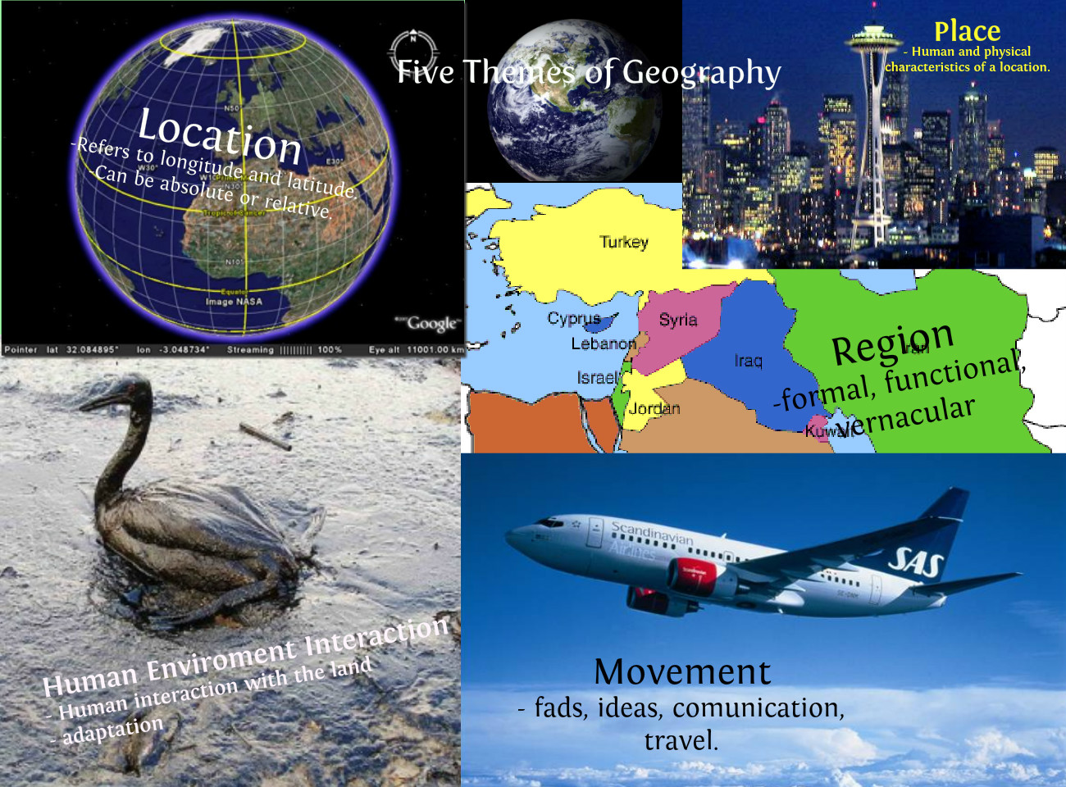
5 Themes of Geography
Location (absolute and relative)
Place
Region
Movement
Human-Environment Interaction

Slide 3
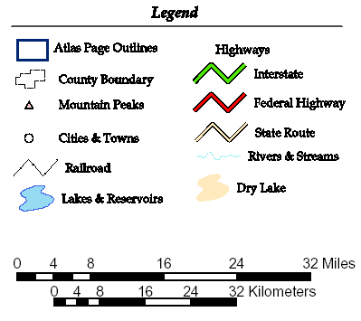
Reading a Map
Legend
Lists symbols, lines or colors on a map.
Compass Rose
Shows directions on a map.
Scale
Shows the ratio between a unit of length on a map and a unit of distance on the earth.

Slide 4
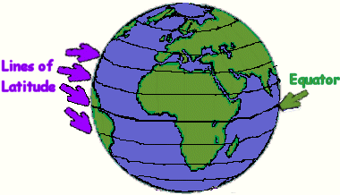
Lines of Latitude
Imaginary lines that run east and west around the globe.
The equator is a lone of latitude that measures 0˚
Used to measure the distance in degrees north and south of the equator,
The Tropics of Cancer and Capricorn are parallels that form the boundaries of the Tropics, a region that stays warm all year long.

Slide 5
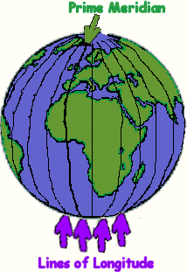
Lines of Longitude
Imaginary lines that run north and south around the globe.
Also known as meridians.
Shows distance in degrees east or west of the prime meridian
The Prime Meridian is a line of longitude that measures 0˚.

Slide 6
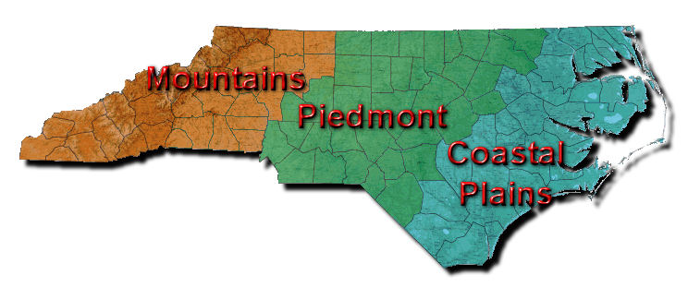
North Carolina’s Land Regions
North Carolina is divided into three distinct geographic regions
Coastal Plains
Piedmont
Mountain
A geographic region is a large area of land with a common set of features.

Slide 7
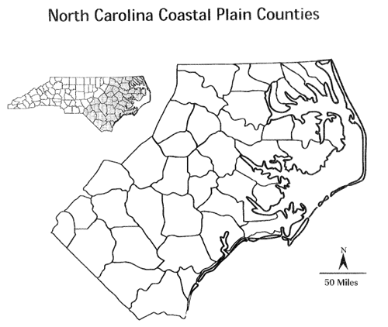
The Coastal Plains
Broad, flat land that extends from the Atlantic Ocean to the Piedmont.
The Outer Banks are a long chain of sandy islands located in the Coastal Plain
Known as the “Graveyard of the Atlantic” due to many shipwrecks.
Contains loam, which is a thick, black soil that makes the Coastal Plain good for farming.

Slide 8
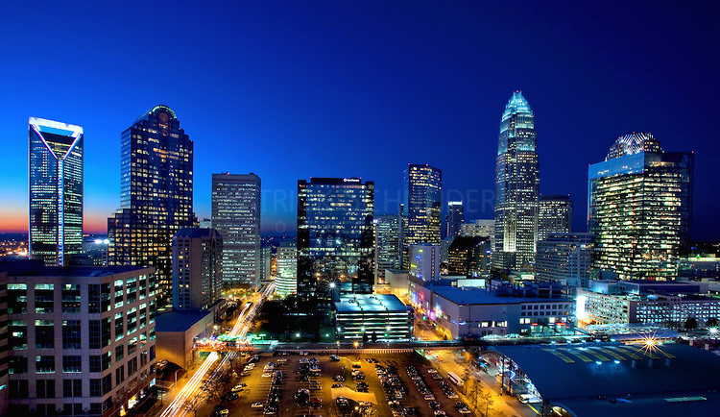
The Piedmont
Hilly region between the Coastal Plain and the Appalachian Mountains.
Elevation between the coastal plain and piedmont change so dramatically that many rivers spill off into waterfalls
This is called the fall line.
Many of NC’s cities are located in the piedmont.

Slide 9
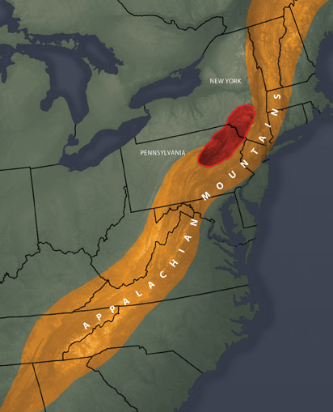
The Appalachian Mountains
Mountain range that begins at the western edge of the piedmont.
Highest elevation of the 3 regions.

