Slide 1
Battles of the American Revolution

Slide 2
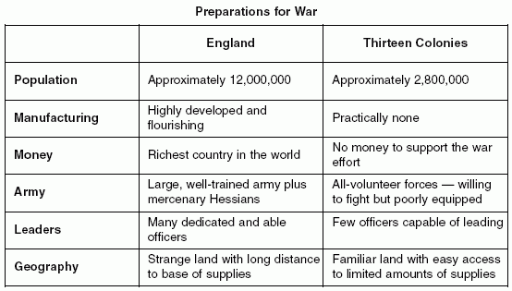
England v. America Who do you think should win?

Slide 3
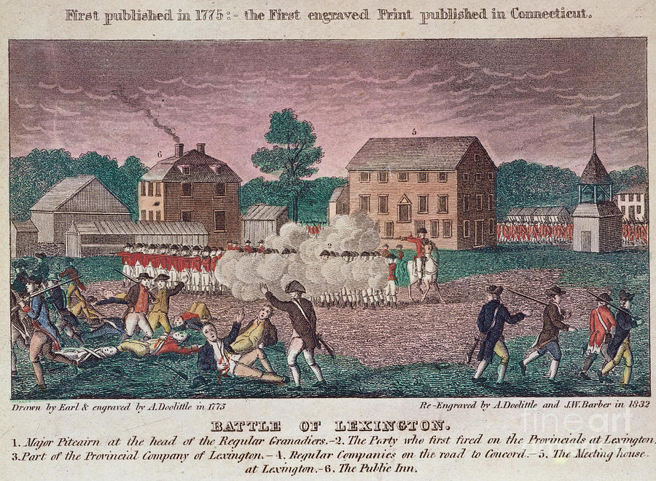
The Battle of Lexington and Concord
The British marched towards Concord to confiscate weapons the colonists hid.
Paul Revere, William Dawes, and Samuel Prescott warn colonists the British are coming.
British reach Lexington to find colonists ready for war.
First shots called “The shot heard around the world.

Slide 4
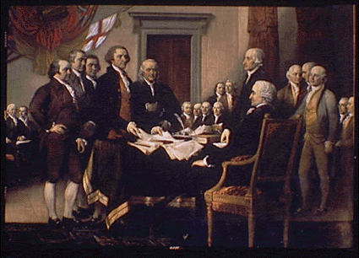
The Second Continental Congress
Representatives from the colonies met to deal with the growing threat of war.
Voted to create an American army called the Continental Army.
Chose George Washington to lead it.
Voted to declare independence from Britain.

Slide 5
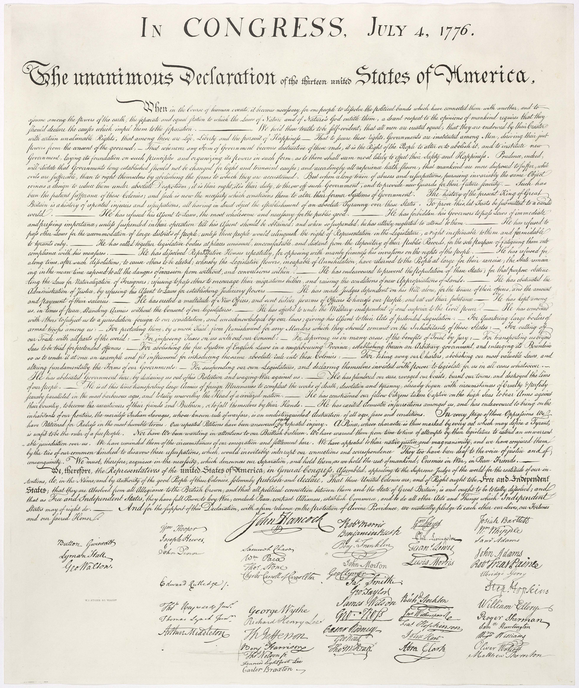
The Declaration of Independence
Written by Thomas Jefferson.
Explained why the colonies wanted to separate from Britain.
Listed all of the wrongs the colonists suffered under King George III.
Listed the rights the newly independent states would now have.

Slide 6
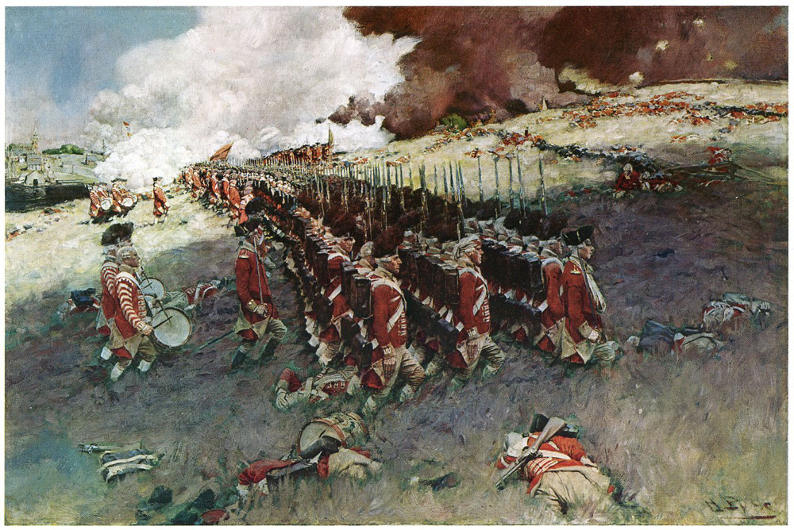
The Battle of Bunker Hill
Americans built a fort on Breed’s Hill.
British attacked fort using cannons.
Though the British force the colonists to retreat, over 200 British soldiers were killed.
Showed that the colonists could fight with the British.

Slide 7
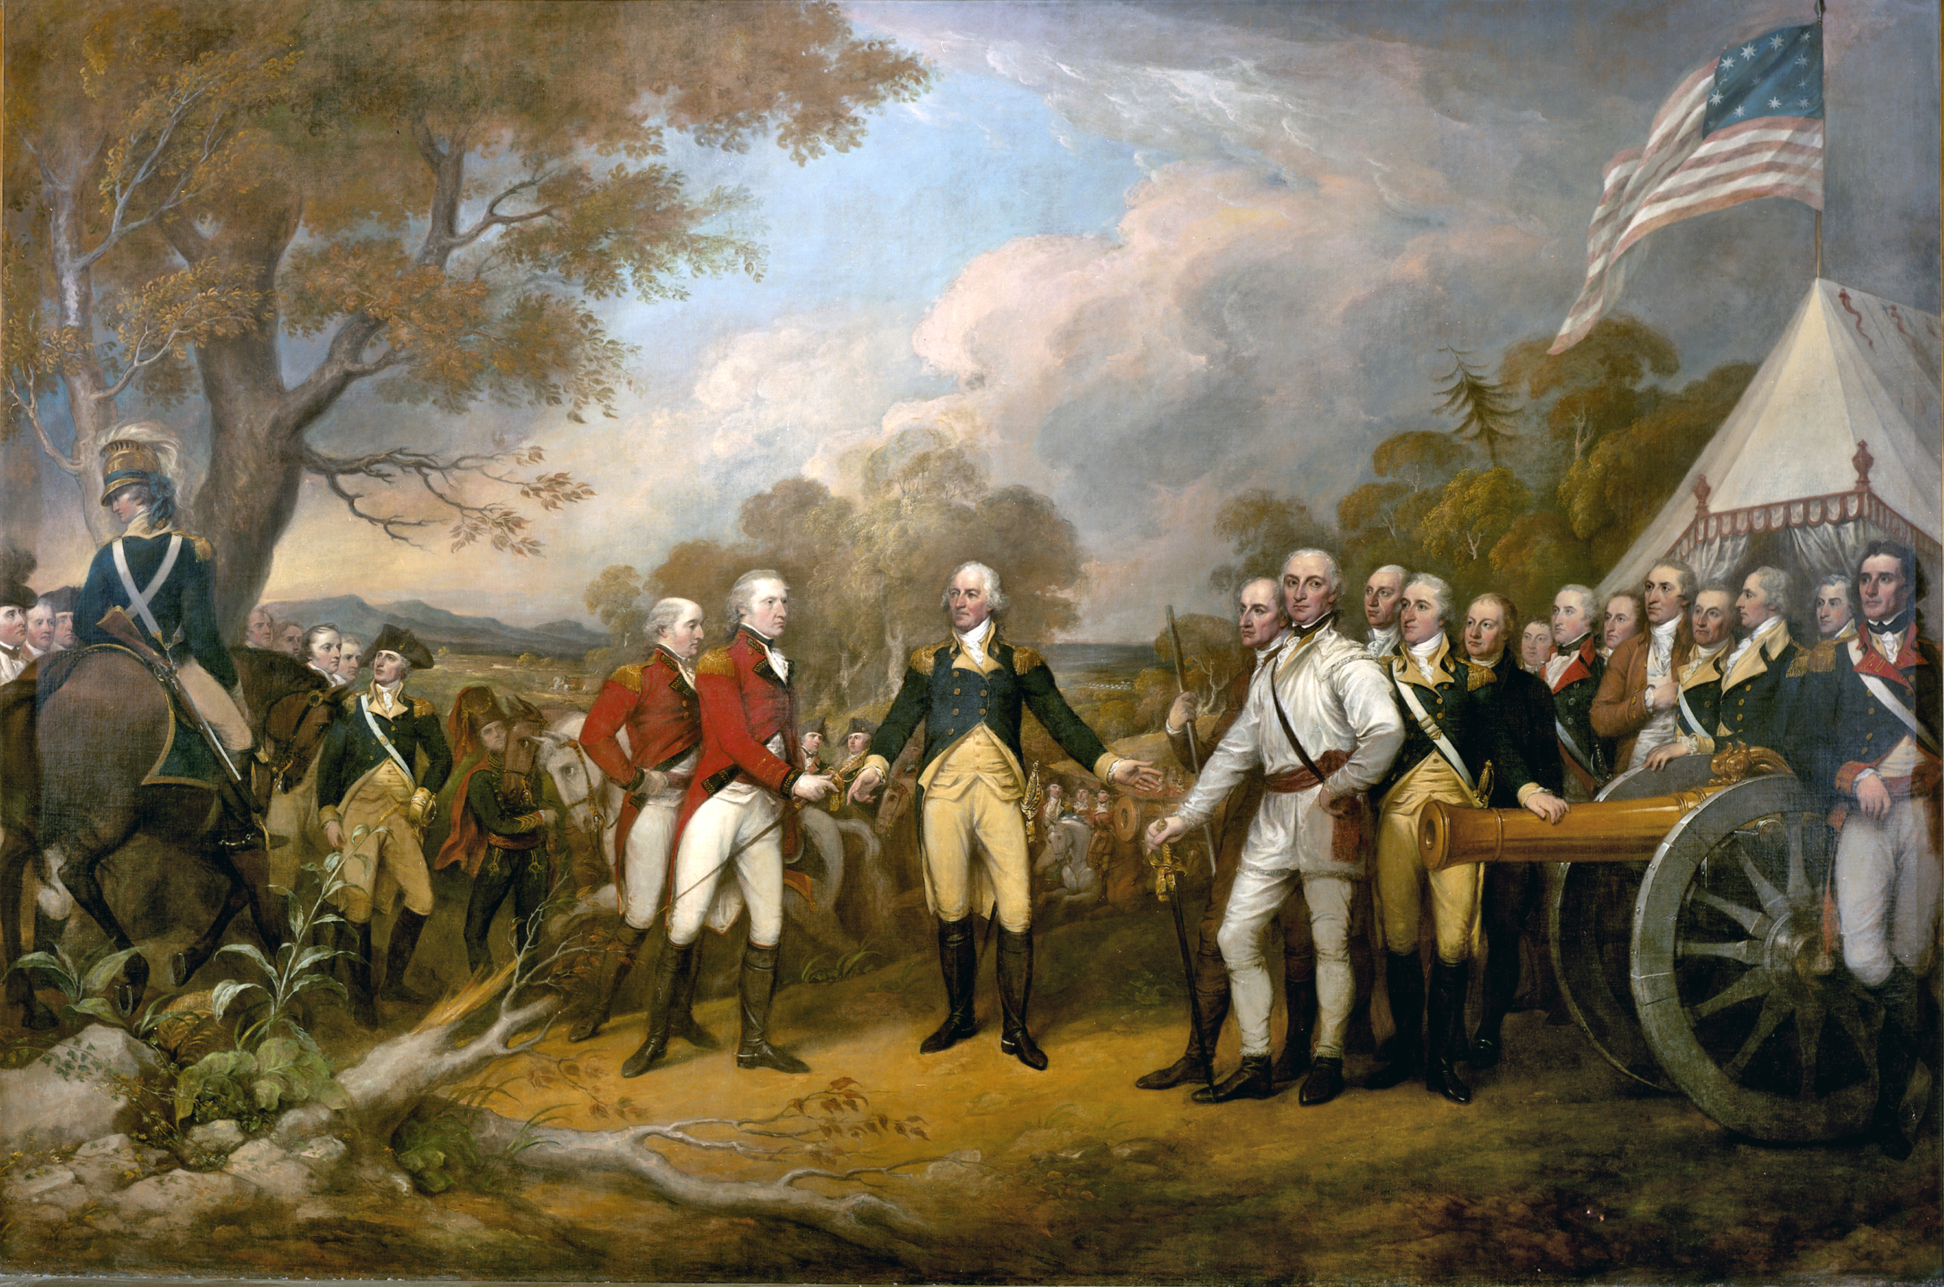
Battle of Saratoga
The British planned to split NY in half and defeat the colonies separately.
Colonists defeat British soldiers in Saratoga NY.
Ruined Britain's plan.
Turning point of the Revolutionary War.

Slide 8
Battle of Moore’s Creek Bridge
First battle in NC.
Loyalists planned to meet with British.
Patriots hid by a bridge.
They also greased the bridge and removed planks.
50 loyalists were killed.
Only 1 patriot.
“Lexington and Concord of the south”
Helped prevent Britain from gaining control of the south.

Slide 9
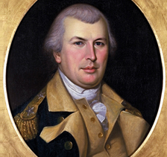
The Battle of Guilford Courthouse
Nathanael Greene = commander of the Continental Army in the south.
Fighting occurred in Greensboro.
Patriots retreat, but Cornwallis lost ¼ of his men.
Gave Americans more confidence.

Slide 10
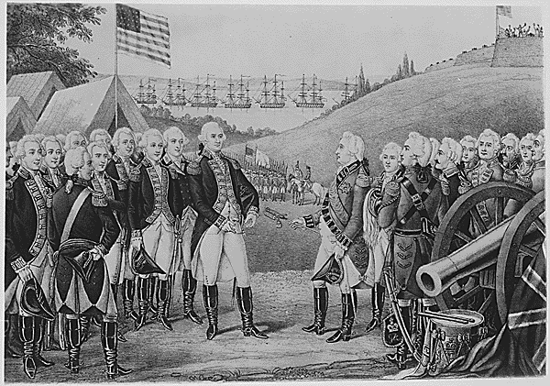
Battle of Yorktown
Cornwallis falls into a trap by the Americans.
7,000 French soldiers arrive along with 20 warships to blockade the British.
Cornwallis is left with no choice, but to surrender.

Slide 11
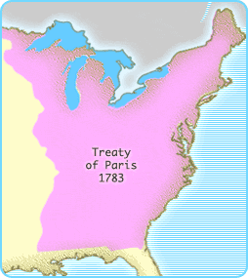
Treaty of Paris, 1783
Britain forced to recognize American independence.
Loyalists would not be punished.
British and Americans had to pay the money owed to each other.
British forced to leave the United States.

Slide 12
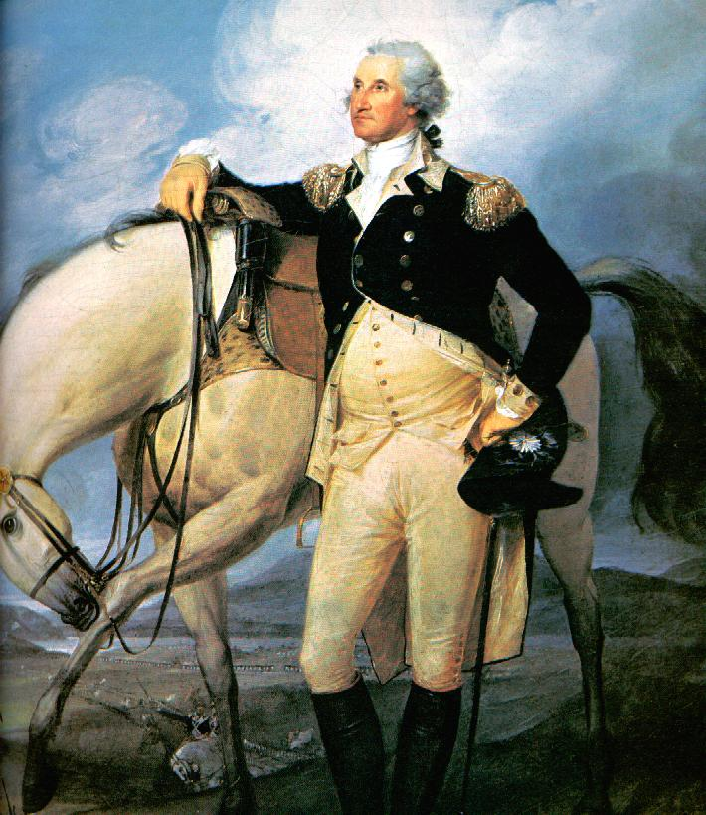
Keys to American Victory
Home field advantage.
Americans knew the land and didn’t have to wait for supplies.
Tactics and Leadership
Didn’t fight like the British,
Used guerilla Warfare learned from Native Americans.
George Washington proved to be a superior general.
Help from the French.
Winning meant more to the Americans.

