Slide 1
Forming a New Nation
Chapter 11

Slide 2
The Articles of Confederation
Following the American Revolution, many states realized the need for a national government.
The Articles of Confederation is approved.
Divided power between state and national government.
Had major weaknesses
State governments had more power than the central government.
Central government could not impose taxes.

Slide 3
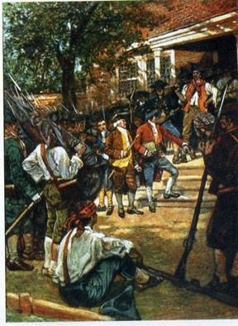
Shays’ Rebellion
Massachusetts forced land owners to pay high taxes.
A group of farmers led by Daniel Shays seized guns and overthrow the government.
Massachusetts asked congress for help, but they did not have the power to provide help to states.
Proved that the Articles of Confederation could not work.

Slide 4
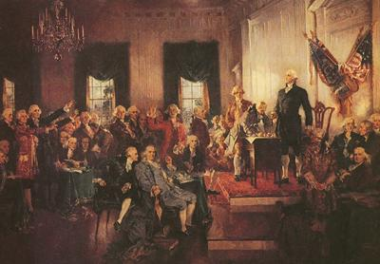
The Constitutional Convention
Originally wanted to revise the Articles of Confederation, but decided to create an entirely new constitution.
Made the national government stronger by giving it the power to collect taxes and regulate trade.
Delegates decided that the government should have three parts: Congress, President, and Courts

Slide 5
The Great Compromise
The biggest disagreements were over how many votes each state should have in congress.
Bigger states thought it should be based on population (Virginia Plan)
Smaller states thought every state should have equal votes(New Jersey Plan)

Slide 6
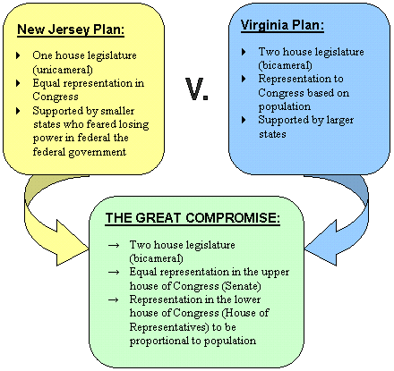
The Great Compromise Cont.
Delegates finally agree on the Great (Connecticut) Compromise.
The legislature(Congress) would have two houses.
The Senate
Each state will have two members.
The House of Representatives
Number of representatives would be determined by states population.

Slide 7
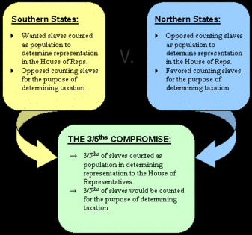
Three-Fifths Compromise
Since representation was determined by population, delegates debated the issue of slavery.
Southern states wanted slaves to be counted towards representation, but not taxation.
Northern states wanted slaves to be counted for taxation, but not representation.
3/5’s Compromise says that 3 out of 5 slaves will be counted towards taxation and representation.

Slide 8
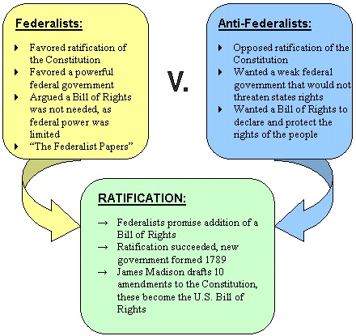
Ratification of the Constitution
After 4 months, the Constitution is finished, but now needs to be approved, or ratified, by 9 states.
Federalists
People who supported the Constitution.
Antifederalist.
People who opposed the Constitution.
Feared it gave central government too much power and did not protect people’s rights.

Slide 9
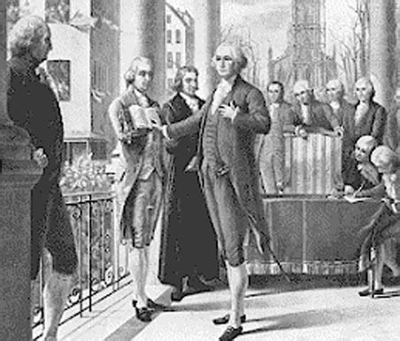
The Constitution is Approved
The Constitution is approved by 11 states in 1788.
Only North Carolina and Rhode Island have not approved it.
George Washington is elected the first president of the US.
Takes the Oath of Office in NYC, which is the capital at the time.

Slide 10
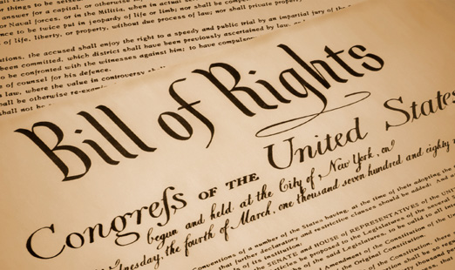
The Bill of Rights
In 1791, Congress formally adds ten amendments to the Constitution.
Became known as the Bill of Rights.
Guaranteed individual rights to citizens of the US.
Freedom of speech, religion, press, etc.

