Slide 1
The War of 1812
Chapter 11 Section 4

Slide 2
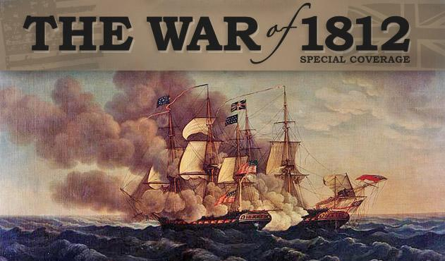
Tension with Britain Continues
Relations remained tense between Britain and U.S. following American Revolution.
Britain created a blockade so American ships could not give France supplies.
Impressment, or kidnapping, of American Sailors.

Slide 3
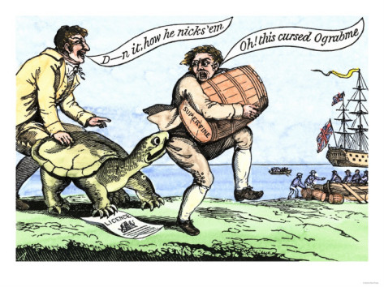
Embargo Act of 1807
President Jefferson did not want to get involved in foreign affairs.
Signed the Embargo Act of 1807.
American ships were forbidden to sail to foreign ports and American ports were closed to British ships.

Slide 4
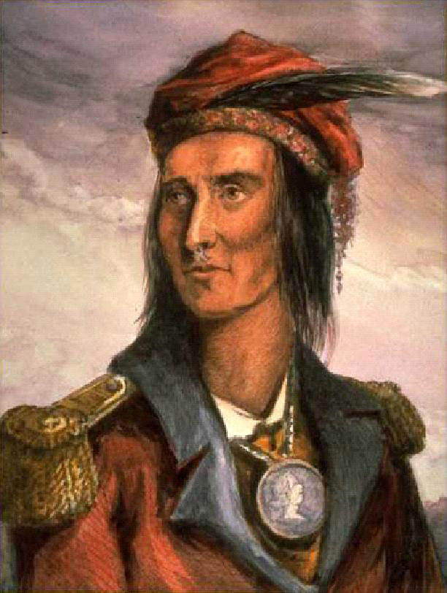
Conflict with Natives leads to War
Tecumseh united natives to fight against Americans as they moved west.
William Henry Harrison defeats Tecumseh at the Battle of Tippecanoe.
War Hawks demand war with the British because they helped the Natives

Slide 5
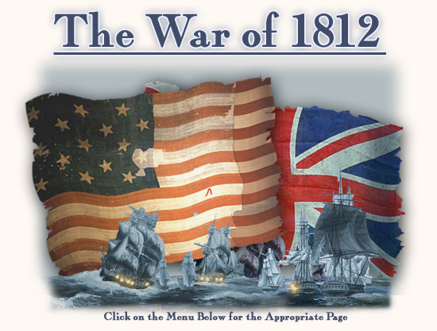
War Begins
War is declared June 18, 1812, but there is little fighting for 2 years because Britain is busy fighting France.
Once Britain defeats Napoleon in 1814, the fighting really begins.

Slide 6
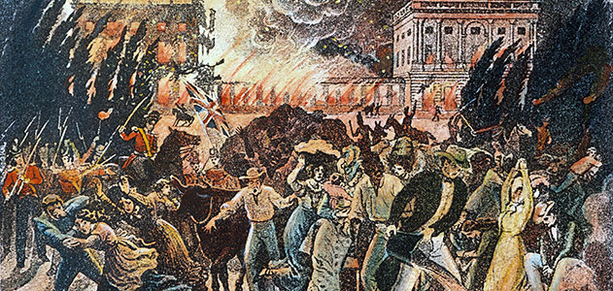
Early Fighting
Britain is able to capture many U.S. cities including Washington D.C.
They burn it to the ground.
President James Madison is forced to flea.
His wife, Dolly Madison stays to save important historical objects.

Slide 7
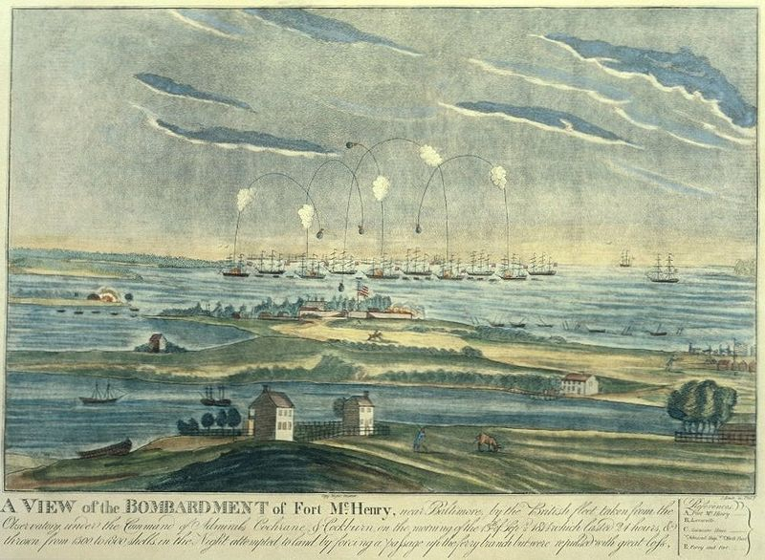
Battle of Fort McHenry
Americans are able to defeat the British.
During this battle, Francis Scott Key writes a poem about the pride he felt upon seeing the American flag still waving.
This poem later becomes “The Star-Spangled Banner”

Slide 8
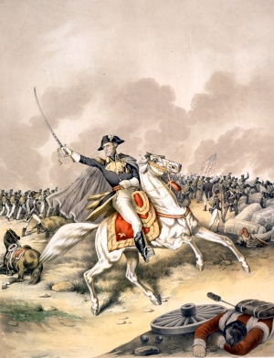
The Battle of New Orleans
7,500 British troops approached New Orleans.
General Andrew Jackson leads Americans into battle.
Though outnumbered, Jackson’s men destroy the British.
Casualties: 2,000 British
71 Americans

Slide 9
The Battle of New Orleans
Decisive victory for Americans, but the battle was unnecessary.
The Treaty of Ghent was signed 2 weeks earlier.
Slow mail from Europe delayed the news from reaching the U.S. before the battle began.

Slide 10
Consequences of the War
No clear winner.
Nothing really changed after the war.
American’s had fewer ties with Britain.
Trade with Europe decreased.
U.S. emerges as world power.

