Slide 1
Events Leading to the Civil War
Chapter 14

Slide 2
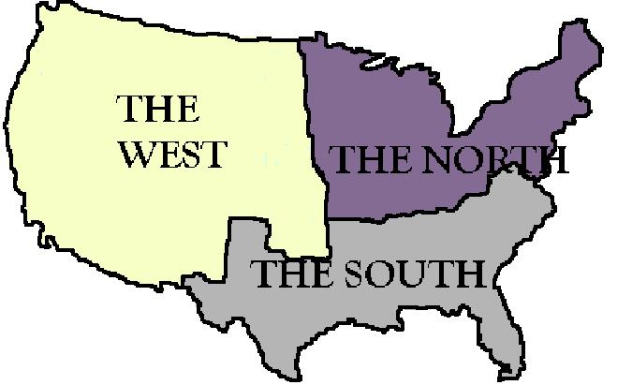
Sectionalism
As different areas of the US develop differently, each section becomes loyal to the interest of their own section of the country.
This is called Sectionalism
The Southern states relied on agriculture.
Mostly cotton.
Relied on slave labor.
The Northern states relied on manufacturing and trade.

Slide 3
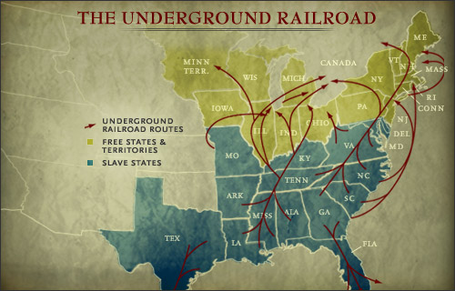
Resistance to Slavery
Beginning in the late 1700’s, abolitionists began calling for an end to slavery
Examples: William Lloyd Garrison and Frederick Douglass
Many slaves attempt to escape to the North using the Underground Railroad.
Harriet Tubman leads hundreds of slaves to freedom.
Other slaves lead revolts against their owners.
In 1831, Nat Turner leads a rebellion in Virginia leaving 55 white men, women and children dead.

Slide 4
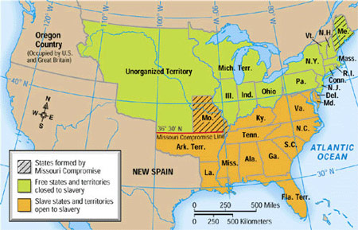
The Missouri Compromise
As the US expands westward and territories are added, people debated whether these newly acquired lands should allow slavery or not.
Missouri wanted to be added as a slave state.
Northerners worried that this would give slave states an advantage in congress.
Henry Clay proposes the Missouri Compromise
Missouri enters as a slave state.
Maine enters as a free state.
Slavery would be banned in all territories north of 36˚30’.

Slide 5
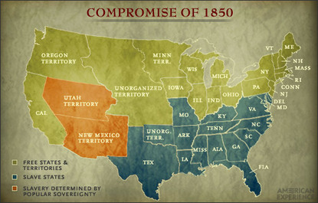
Compromise of 1850
In 1849, gold attracts many settlers into California and by 1850, Californians want to be admitted as a free state.
Would upset the balance of slave and free states.
Henry Clay proposes the Compromise of 1850
California enters as a free state
Newly added states would be able to decide the issue of slavery for themselves.
Popular sovereignty
Made stronger Fugitive Slave Laws.

Slide 6
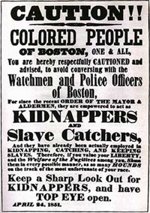
Fugitive Slave Laws
It was a law that required citizens to catch runaway slaves.
If a person did not comply, they could be fined up to $1000 or put in jail for six months.
Judges received $10 if they returned a slave and $5 if they freed them.
Many blacks who were free were captured and sent back into slavery.
Northerners hated this law because it forced them to become a part of the system of slavery.

Slide 7
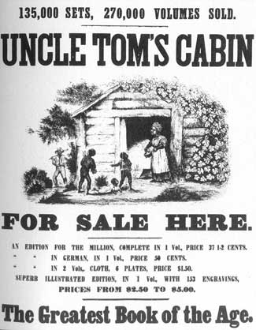
Uncle tom’s Cabin
A novel written by Harriet Beecher Stowe.
Dramatically portrayed the moral issue of slavery.
Uncle Tom’s Cabin was extremely popular in the North.
Southerners believed the book falsely criticized the South and slavery.

Slide 8
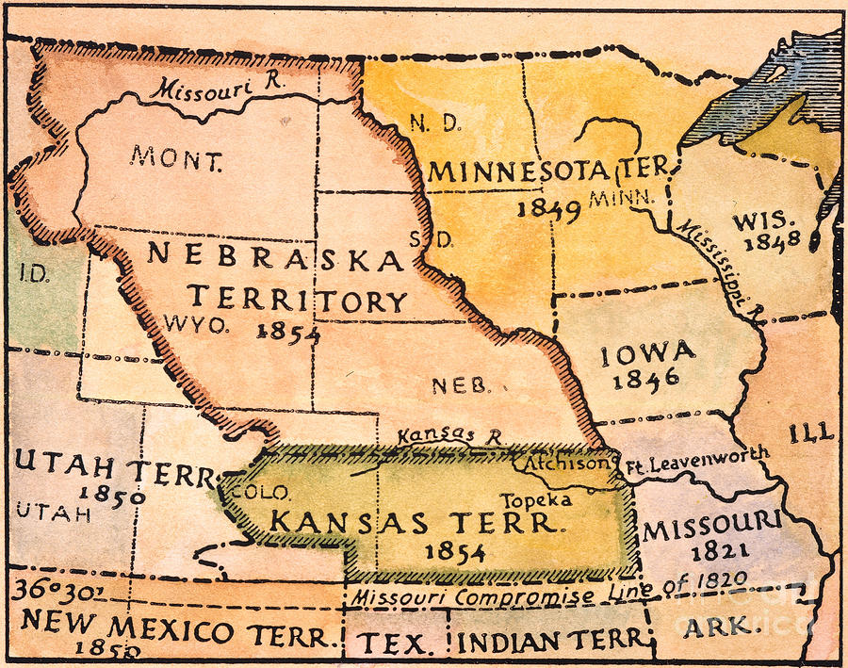
Bleeding Kansas
The Kansas-Nebraska Act allows each territory to determine if they would allow slavery by popular sovereignty.
Proslavery and Antislavery settlers rushed into the Kansas Territory to sway the vote in their favor.
Fighting eventually breaks out and lasts for 3 years.
Nicknames “Bleeding Kansas”
Kind of a mini Civil War.

Slide 9
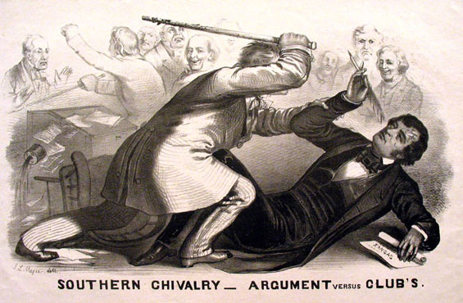
Violence in Congress
While violence in Kansas was spreading, Senator Charles Sumner of Massachusetts delivered a speech attacking proslavery forces in Kansas.
Preston Brooks, a southerner, heard the speech and attacked Sumner using his cane as a weapon.
“Bleeding Kansas” and “Bleeding Sumner” became rallying cries for antislavery Northerners.

Slide 10
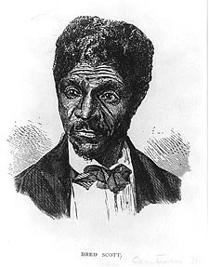
Dred Scott V. Sandford
Dred Scott was a slave in Missouri, but his owner took him into territories where slavery was illegal, then back into Missouri.
When his owner dies, Scott sued for his freedom.
His case eventually reaches the Supreme Court.
The Court rules against Scott.
Said that slaves were property, not US citizens, and therefore could not sue in US courts.

Slide 11
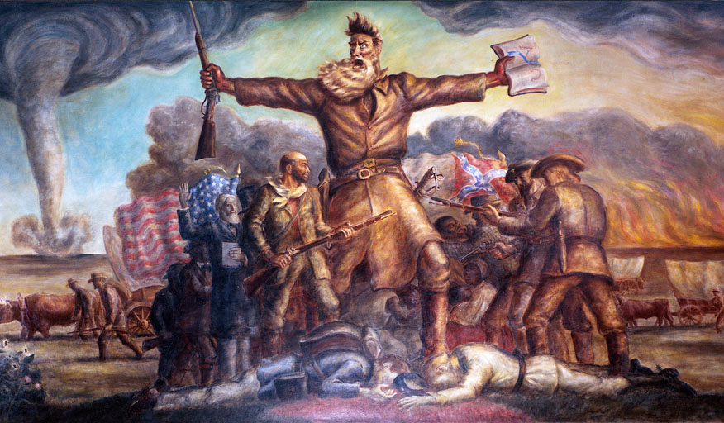
John Brown’s Raid
John Brown, who had fought proslavery settlers in Kansas, wants to inspire slaves to fight for their freedom.
Along with his sons and other followers, Brown is able to take the arsenal at Harpers Ferry.
Browns plan is to rally and arm local slaves.
No slaves join the fight.
Brown is captured and tried for murder and treason.
He is hung.

Slide 12
Election of 1860
Abraham Lincoln runs for president again John Breckinridge.
Lincoln does not want slavery to expand into the territories, but does not want to outlaw slavery.
Lincoln wins the election since the North has a higher population than the south.
The South fears that Lincoln will soon outlaw slavery.

Slide 13
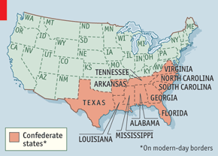
Southern States Secede
Southern states had warned that if Lincoln had been elected, they would secede.
Based their arguments on the idea of states’ rights.
Claimed that since they voluntarily joined the Union, they had the right to leave.
South Carolina is the first state to secede, but is soon followed by other states.
Create the Confederate States od America
Name Jefferson Davis the President.

