Slide 1
The Civil War
Chapter 15

Slide 2
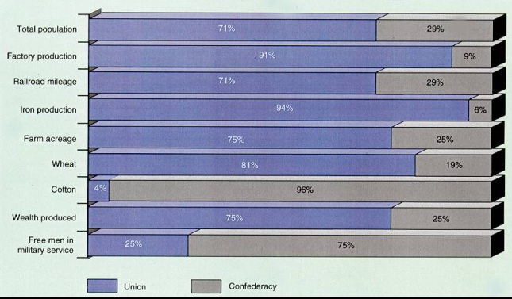
Comparing Advantages

Slide 3
Comparing Advantages
Union
Confederacy
Experienced Federal Government
Twice the population
Had 80% of nations manufacturing.
Better transportation
Railroads
Leadership
Robert E. Lee
Had more to lose.

Slide 4
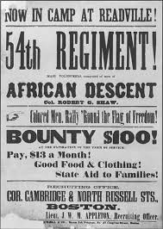
Gathering Armies
Many people volunteer, but later many are drafted.
Draftees can pay substitutes or pay $300 to be exempt.
African Americans
Not allowed to fight at first.
Later allowed to fight for the Union.
Women
Some fought as soldiers.
Many were nurses.
Clara Barton was a nurse who later found the Red Cross.

Slide 5
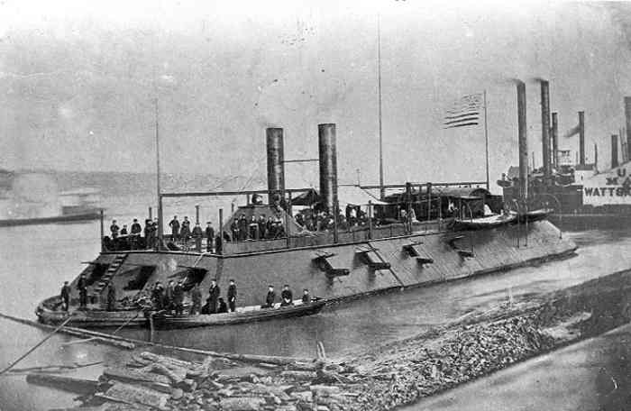
Changes in Military Technology
The Civil War is the first war since the Industrial Revolution, which leads to technological advancements.
Also causes more casualties
Rifle
Better accuracy from long distances.
Ironclads
Warships covered with Iron
Monitor and Merrimack

Slide 6
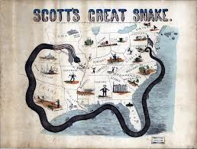
Fighting Begins
First shots are fired at Fort Sumter.
In response, the Union blockades the south using the Anaconda Plan.
Included a naval blockade, seizure of the Mississippi River and the capture of Richmond.
Prevents the south from selling its cotton overseas in return for supplies.
The South planned to gain support from Britain and France because of their dependence on cotton.

Slide 7
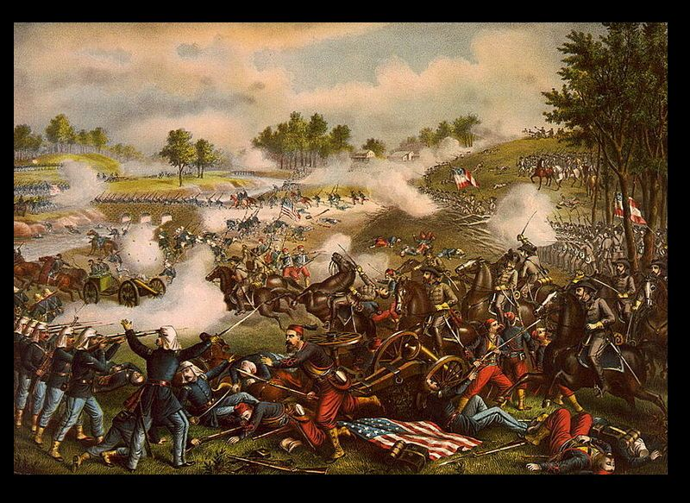
The First Battle of Manassas (Bull Run)
Union forces are sent to Richmond, Virginia.
Many people watch the battle from a distance, expecting an easy victory.
Confederacy rally’s behind General Thomas “Stonewall” Jackson and defeat the Union.
Shows that the war will not end quickly.

Slide 8
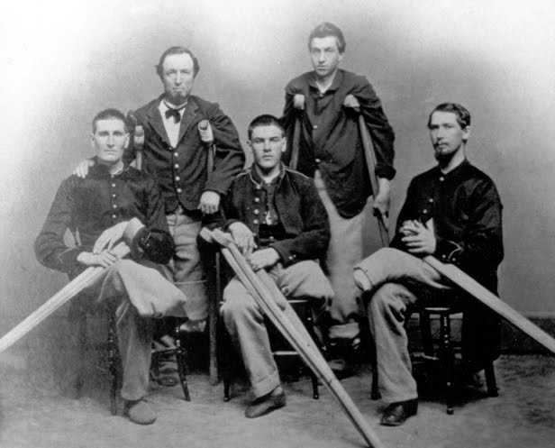
Life in the Army
Poor hygiene resulted in widespread sickness.
People did not know they germs caused diseases.
Twice as many men die from disease than from battle.
Crude medical care
Most surgeries performed during the civil war were amputations.

Slide 9
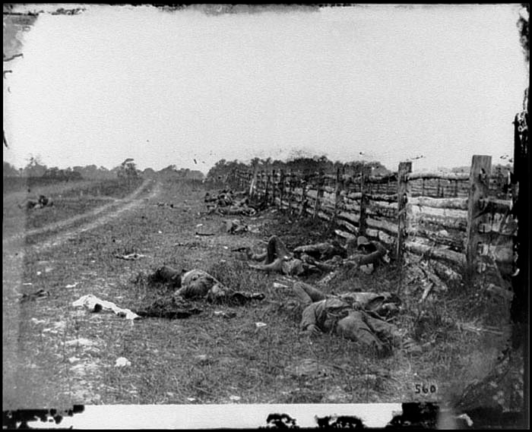
Battle of Antietam
General Lee begins to invade the North.
Lee’s soldiers are attacked near Sharpsburg, Maryland.
Bloodiest single day of the Civil War.
25,000 dead or wounded
No winner, but Lee retreats.

Slide 10
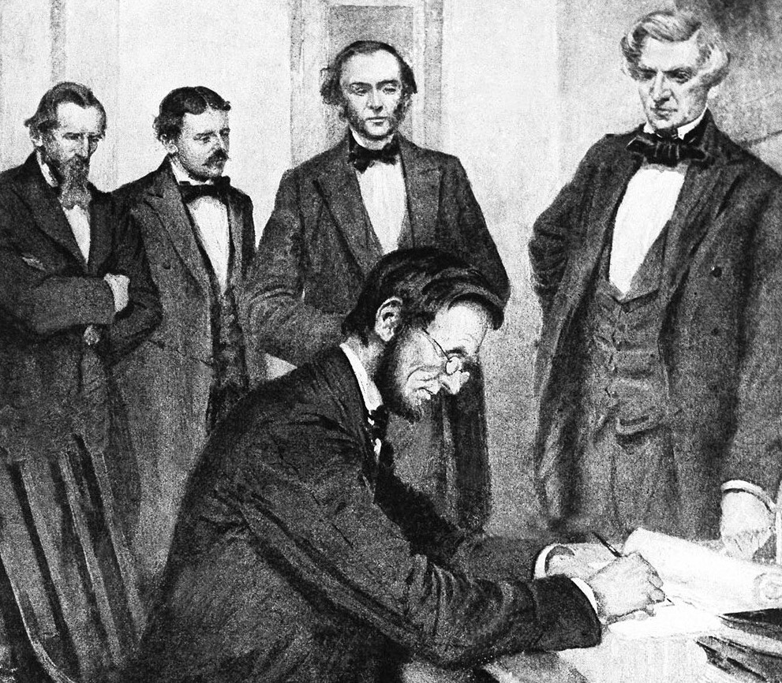
Emancipation proclamation
Many abolitionists urged Lincoln to outlaw slavery, but he was hesitant to do so.
Signs the Emancipation Proclamation in 1863.
Frees all slaves in Confederate territory.
Freed very few slaves.
Lincoln instead hoped to weaken the South and gain support from Britain.

Slide 11
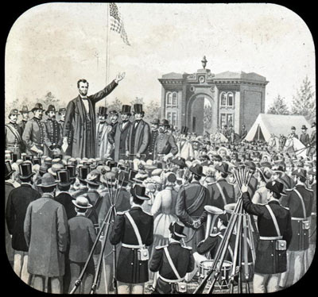
The Battle of Gettysburg
In 1863, Lee invades the North into Pennsylvania.
Battle lasted three days.
Ended after “Pickett’s Charge”
Major Union victory.
Lee lost 1/3 of his army
Never invades the North again.
Lincoln makes a speech to dedicate a national cemetery on the battlefield.

Slide 12
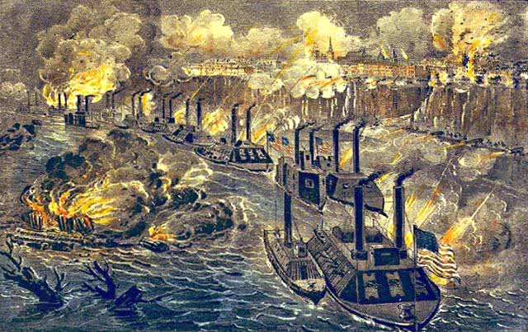
The siege of Vicksburg
Ulysses S. Grant laid siege to Vicksburg.
Victory gives winner control of the Mississippi River.
Confederate soldiers are forced to retreat.
Lincoln appoints Grant the commander in chief of the Union army.

Slide 13
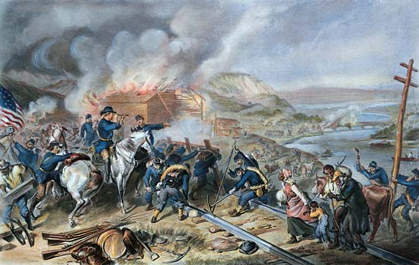
Sherman’s March to the Sea
Sherman wages Total War.
Destroying anything the South can use to fight.
Farms, factories, railroads, telephone wires, bridges, etc.
Sherman and his troops march through Georgia from Atlanta to Savannah.
60 miles long
Destroy everything in their path.

Slide 14
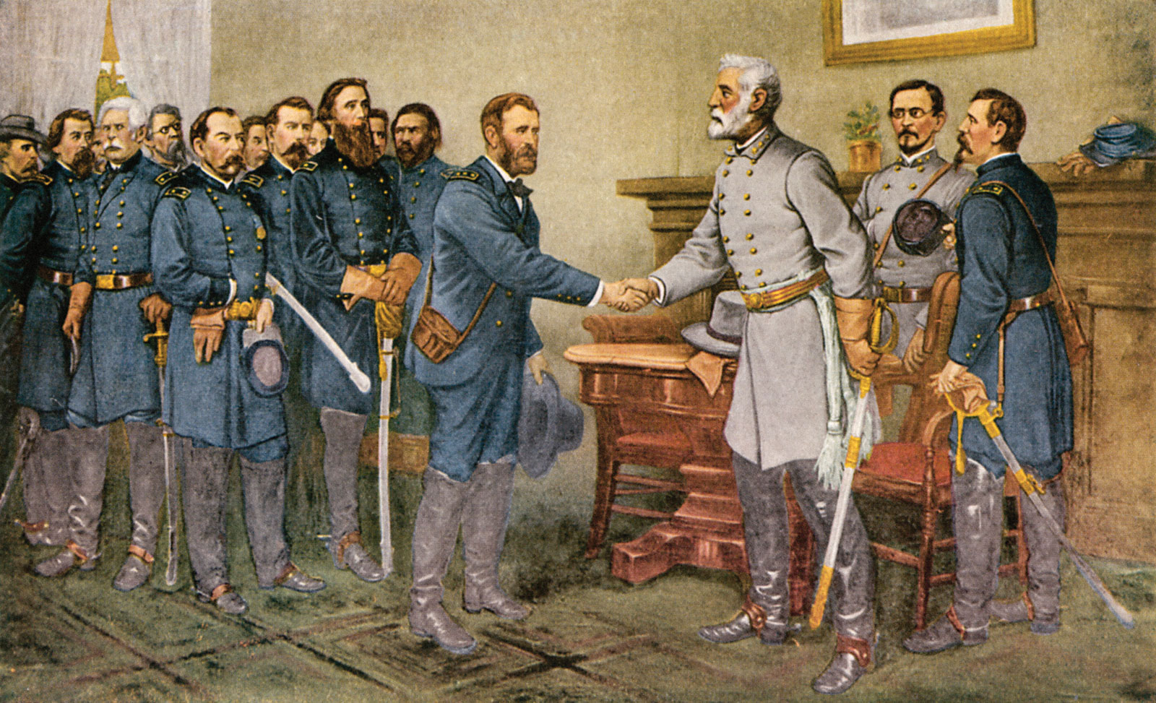
The War Ends
Lee is surrounded at Appomattox Court House.
On April 9, 1865 Lee and Grant meet and Lee surrenders.

Slide 15
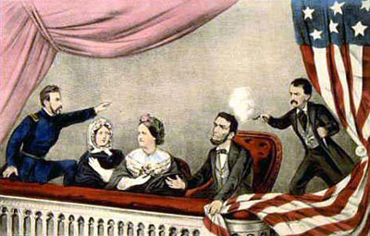
Lincoln’s Assassination
5 days after Lee’s surrender, Lincoln and his wife attend a play at Fords Theatre
John Wilkes Booth sneaks into the balcony and shoots Lincoln in the back of the head.
He jumps from the stage, breaking his leg, but still manages to escape.
Union troops hunt him down and kill him.
Lincoln is rushed to the house across the street, but dies the next morning.

