Slide 1
Reconstruction
Chapter 16

Slide 2
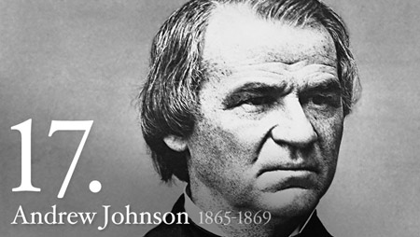
Reconstruction
After the Civil War, the United States faced many challenges.
The cost of war, southern states re-joining the Union, assisting former slaves.
After Lincoln’s assassination, Andrew Johnson becomes president and is left with the task of rebuilding the country.

Slide 3
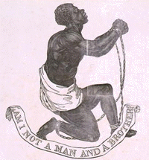
Rebuilding Brings conflict
The Thirteenth Amendment is passed in 1865.
Outlaws Slavery.
Many Southern states passed laws, known as black codes, which limited the freedom of former slaves.
Congress passes the Fourteenth Amendment, which gives equal rights to all citizens.

Slide 4
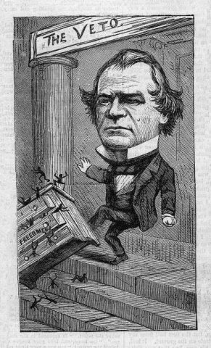
Andrew Johnson Is Impeached
Andrew Johnson disagreed with many laws passed during Reconstruction, including the 14th Amendment.
Vetoed many laws passed in Congress.
The House of Representatives votes to impeach Johnson.
Accuse him of improper conduct while in office.
The Senate decides not to remove Johnson by one vote.

Slide 5
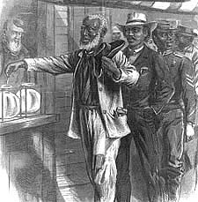
Fifteenth Amendment
Though former slaves were granted citizenship, many states did not allow African Americans to vote.
Poll taxes, literacy tests, grandfather clause.
Congress passes the 15th Amendment, which stated that citizens could not be stopped from voting on account of race.

Slide 6
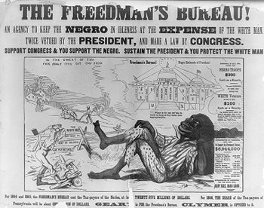
Reconstruction and Daily Life
Though slavery was now outlawed, many former slaves struggled to succeed economically.
No education, no money, most not literate.
Freedman’s Bureau
Agency founded to set up schools and hospitals for African Americans.
Sharecropping

Slide 7
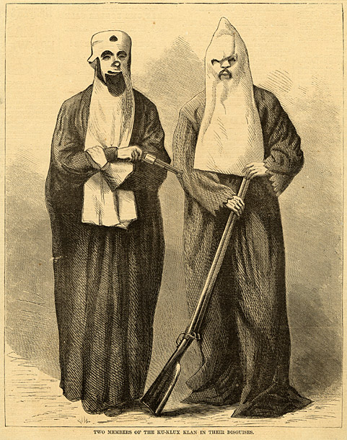
The Ku Klux Klan
Besides poverty, African Americans in the south faced other problems, including violent racism.
The Ku Klux Klan was created to restore Democratic control of the South and keep former slaves powerless.
Used violence and intimidation.
Lynching

Slide 8
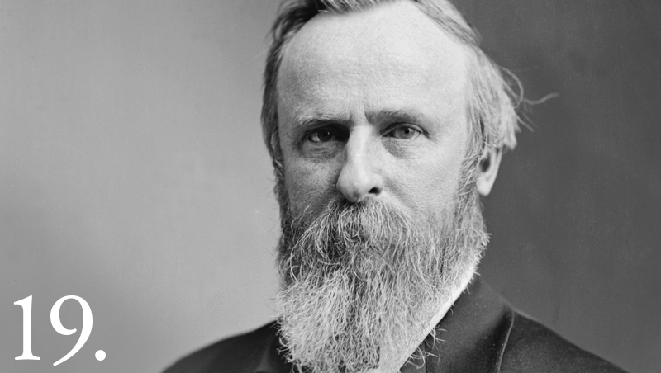
Reconstruction Ends
Reconstruction ends when president Rutherford B. Hayes removes federal troops from the South.
Many historians still argue about the success of Reconstruction.
What do you think?

