Slide 1
The Industrial Revolution
Chapter 17

Slide 2
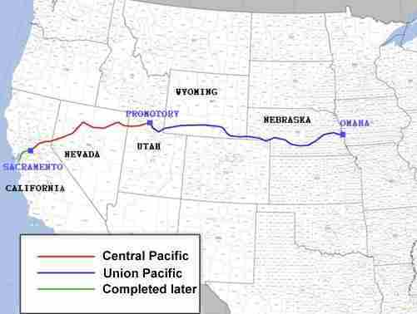
Railroad Industry
The Transcontinental Railroad connects the east and west coasts.
Manifest Destiny
Congress passes the Homestead Act, giving free land to anyone willing to farm it for five years.
Railroad industry controlled by Cornelius Vanderbilt.

Slide 3
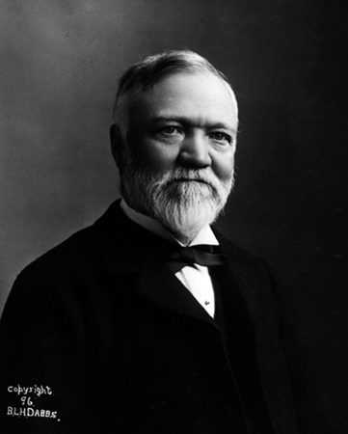
Steel Industry
Made by purifying iron ore through the Bessemer process.
Andrew Carnegie is responsible for the steel industry and becomes one of the richest men in the world.
Andrew Carnegie Video

Slide 4
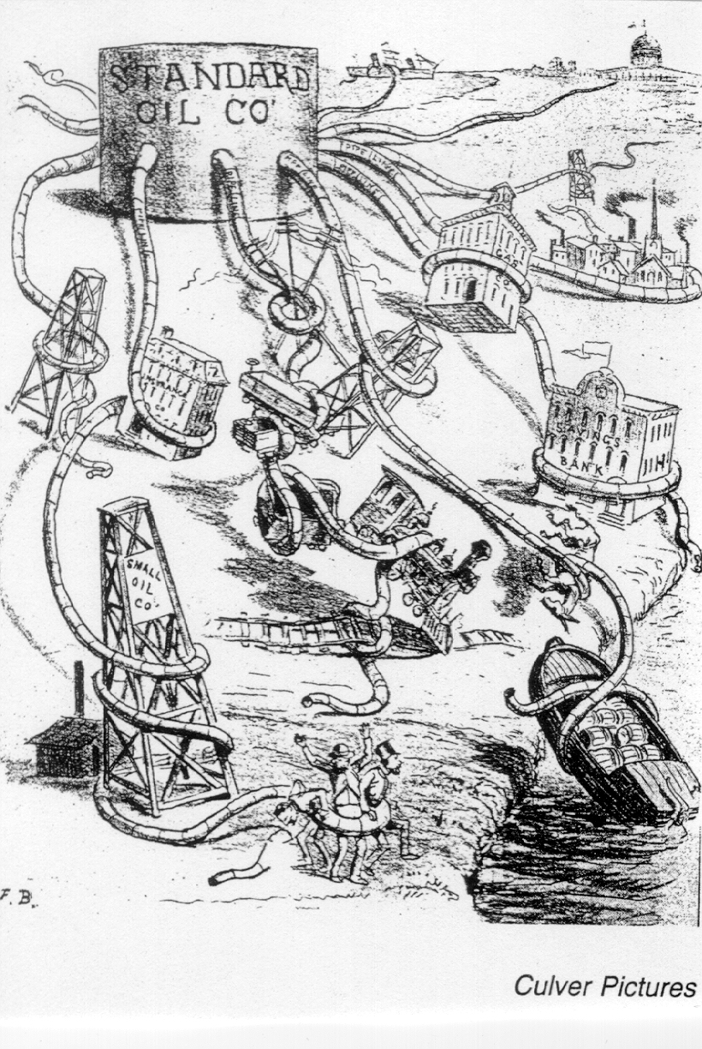
Oil Industry
John D. Rockefeller creates the Standard Oil company.
Controlled 90% of the oil refinery industry.
Rockefeller buys out all of competitors, creating a monopoly.
Becomes extremely rich.

Slide 5
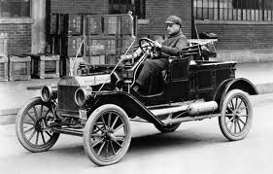
Other Industrial Leaders
Alexander Graham Bell
Invents the telephone in 1876.
Thomas Alva Edison
Most productive inventor.
Took out more patents than anyone in U.S. History.
Thomas Edison Video
Henry Ford
Mass produced automobiles using an assembly line.
Henry Ford Video

Slide 6
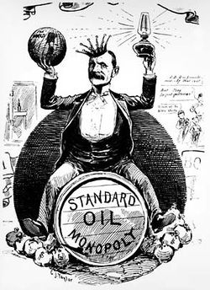
Robber Barons
Many of these men, like Carnegie and Rockefeller, became incredibly rich.
People became concerned that they had too much power.
Called them “Robber Barons” because of their ruthless business tactics.

Slide 7
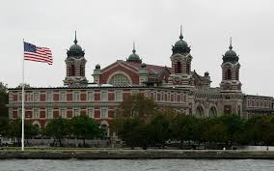
Life in the Country and the City
Urbanization
Movement from rural to urban areas.
Increase in technology, meant less people needed to work on farms.
Immigration
Left Europe to escape poverty and find a job in factories.
7 out of 10 immigrants passed through Ellis Island in NY.

Slide 8
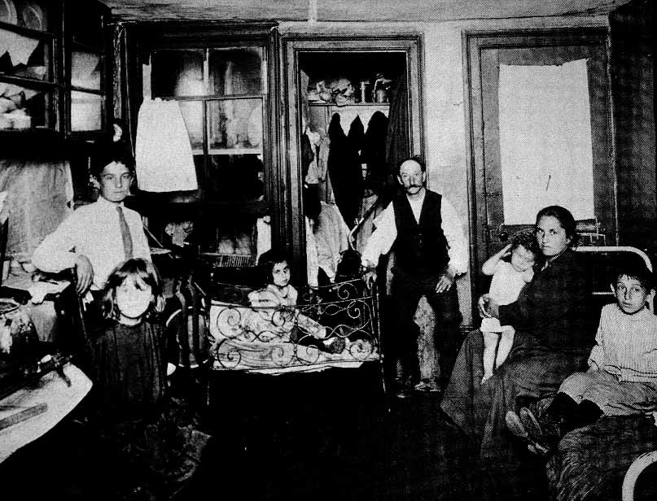
Changes in American Cities
Industry brought new wealth and new jobs.
Movement into cities led to overcrowding and poverty.
Tenements were apartment buildings with tiny rooms and no windows.

Slide 9
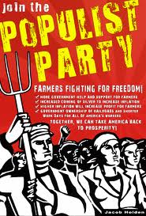
Changes on American Farms
As more crops became available, prices fell.
Means less profit
Farmers being to call for reform.
Crate groups like the Grange and the Farmers Alliance.
Populism
Designed to meet the needs of the common people.

Slide 10
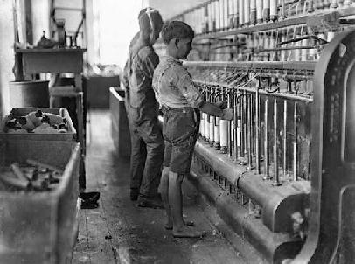
Factory Life
Factory owners became very rich, but paid workers very little.
Also forced to work long hours.
Spent little to no money on health and safety features.
Even use children to help run their factories.

Slide 11
Workers Unite
Factory workers band together and create labor unions to fight for better conditions
Knights of Labor
Threatened to go on strike.

Slide 12
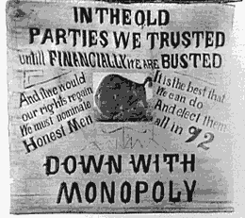
Progressivism
Believed that the government should solve the problems in cities.
Jane Addams establishes Hull House.
Sherman Antitrust Act
Intended to break up Monopolies.

Slide 13
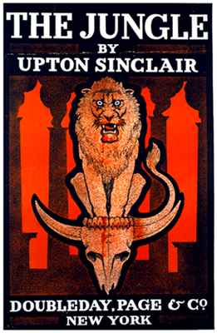
Further Reforms
Muckrakers
Writers that expose corruption
Ida Tarbell’s The History of the Standard Oil Company
Upton Sinclair’s The Jungle
Theodore Roosevelt and Woodrow Wilson are Progressive Presidents.

