Slide 1
The Roaring 20’s
Chapter 19 Section 3

Slide 2
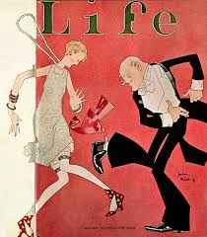
Post WWI
Most Americans wanted to return to neutrality.
America becomes a world superpower.
Americans experience good times and great changes.

Slide 3
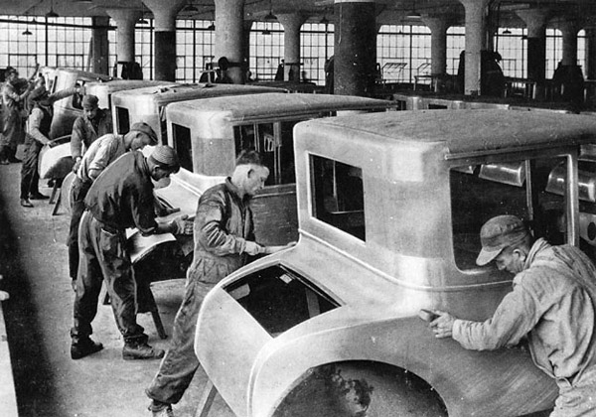
Economic Boom
Consumer goods are available to the average person.
Washing machines, irons, vacuum cleaners, and automobiles.
Americans begin to buy goods on credit.
Includes an extra charge called Interest.
People accumulate A lot of debt, but feel as though the good times will not end.

Slide 4
Americans Gain Rights
Native Americans
Granted citizenship
Given constitutional rights like the right to vote.
African Americans
Creation of the NAACP (W.E.B. Dubois)
Fought for the rights of African Americans
Women
1920-U.S. Government passes the 19th Amendment (Suffrage)
Flappers

Slide 5
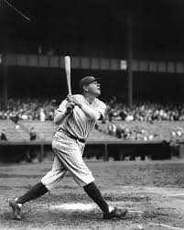
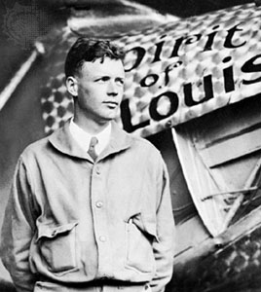
American Heroes of the 1920’s
Babe Ruth
Baseball Player (Boston Red Sox & New York Yankees)
Charles Lindbergh
Flew the Spirit of St. Louis across the Atlantic.
F. Scott Fitzgerald
Author of The Great Gatsby
Louis Armstrong
African American Jazz Musician

Slide 6
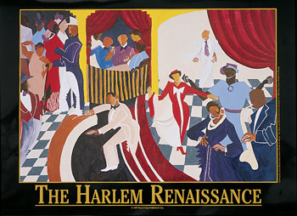
Great Migration
Millions of African Americans move to northern big cities.
Increase in job opportunities.
Harlem Renaissance
Highlighted the cultural achievements of African Americans.
Literacy and the arts.
Langston Hughes, Louis Armstrong, and Duke Ellington

Slide 7
The Red Scare
Communists take control in Russia.
Many fear the same will happen in America.
People were accused of being Communist without any evidence.

Slide 8
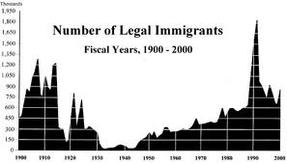
Immigration Reform
Americans feared that immigrants would spread Communism or take jobs from Americans.
Government sets limits on the number of immigrants allowed to enter the country.
Chinese immigrants were not allowed to enter.

Slide 9
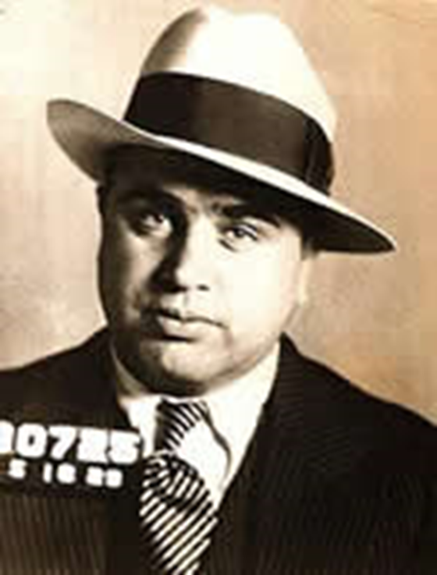
Prohibition
The ban on alcohol leads to an increase in crime.
Bootleggers manufacture alcohol illegally.
Most famous was Al Capone.
Speakeasies were places where people could drink in secrecy,
Since most people disagreed with prohibition, it was impossible to the U.S. Government to enforce.
21st Amendment repeals Prohibition

Slide 10
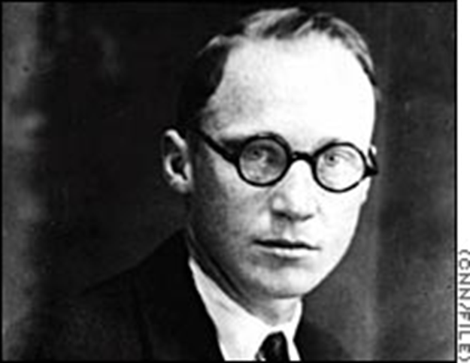
Scopes Trial
Tennessee passed a law making it illegal to teach evolution.
John Scopes does anyway.
Scopes was found guilty and fined $100.

