Slide 1
American Indians in North America and North Carolina
Chapter 2

Slide 2
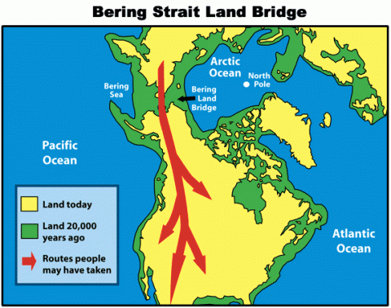
The Land Bridge
Most archaeologists accept that the first people in America crossed the land bridge 12,000 years ago.
The land bridge is located across the Bering Strait, which connects Asia to North America.
The first people who crossed the land bridge were hunters and gatherers who were following their prey.
Mammoths

Slide 3
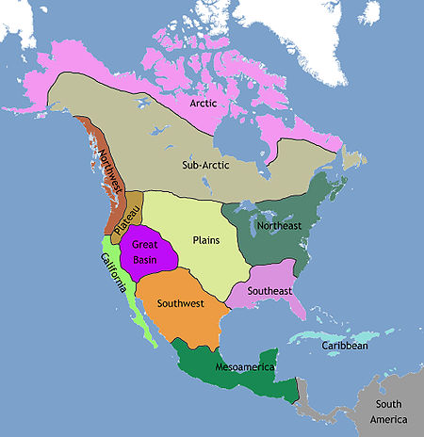
Cultures Develop
As the early Native Americans settled into different areas, their cultures developed differently.
Adapted to their environment
Culture is a peoples way of life.
Includes food, Language, music, and religion.
Archaeologists have grouped them into culture regions where methods of living are alike.

Slide 4
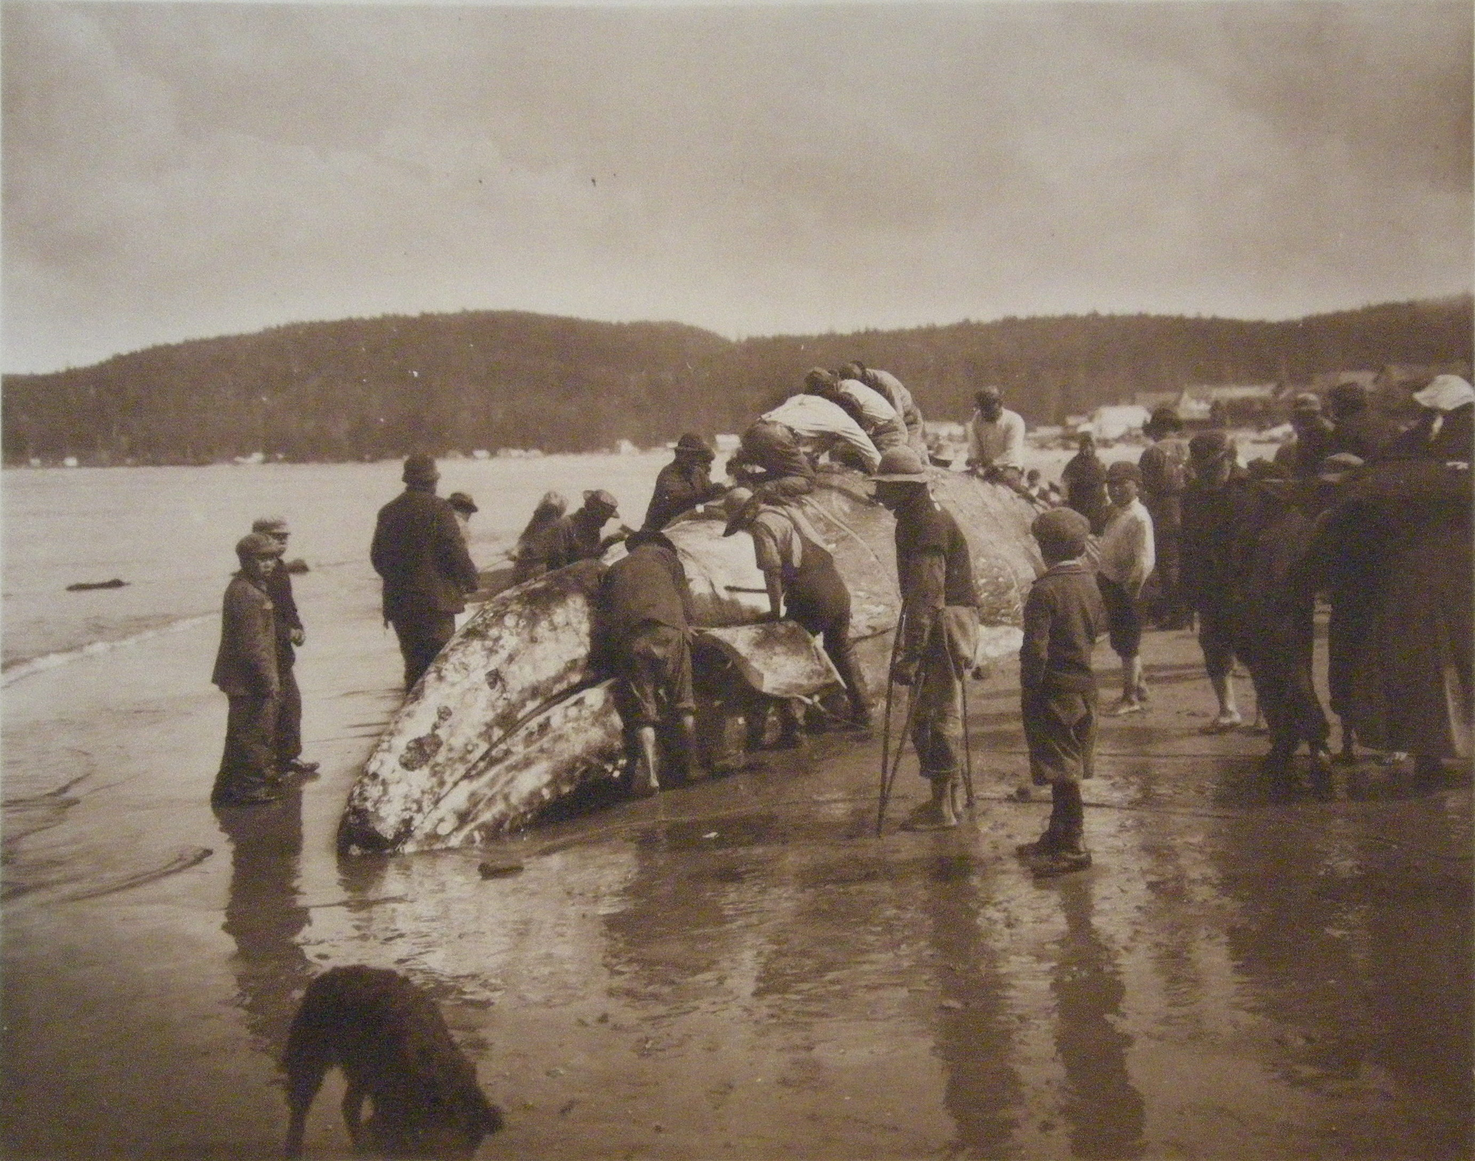
Pacific Northwest
The Makah were the main group of Native Americans in this area
Used the nearby rivers and oceans to yield a wealth of fish and whales.

Slide 5
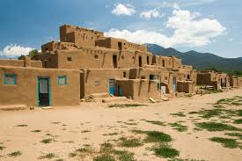
The Desert Southwest
Early people who settled here dealt with many problems.
High temperatures, drought, little food.
Groups such as the Hohokam and the Anasazi used irrigation techniques to get water for farming.
Built adobe villages that would later be known as pueblos.

Slide 6
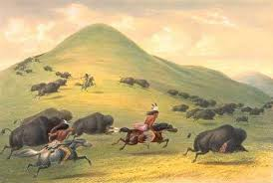
Plains Indians
Settled in the region between the Rocky Mountains and the Mississippi River.
Became completely dependent on the buffalo.
Main source of food.
Also used bones to make tools and weapons
Many Plains Indians were nomads who followed the buffaloes herding patterns.
Lived in houses called teepees

Slide 7
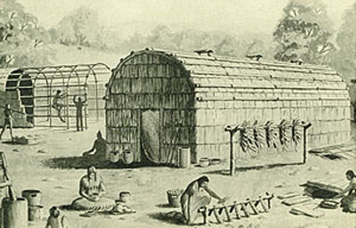
Eastern Woodlands
Lived in the deep forests east of the Mississippi River.
Survived by hunting and farming.
Slash and Burn
Lived in longhouses
5 Iroquois nations banded together to create the Iroquois League.
Aimed at preventing warfare.
Made the Iroquois the most powerful group in the Northeast.

Slide 8
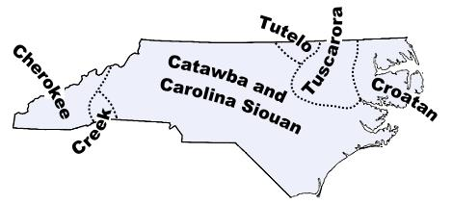
Native Americans in NC
5 Largest Native American groups in NC:
Hatteras
Chowanoc
Tuscarora
Catawba
Cherokee
Tended to live in clans or groups of related people.

Slide 9
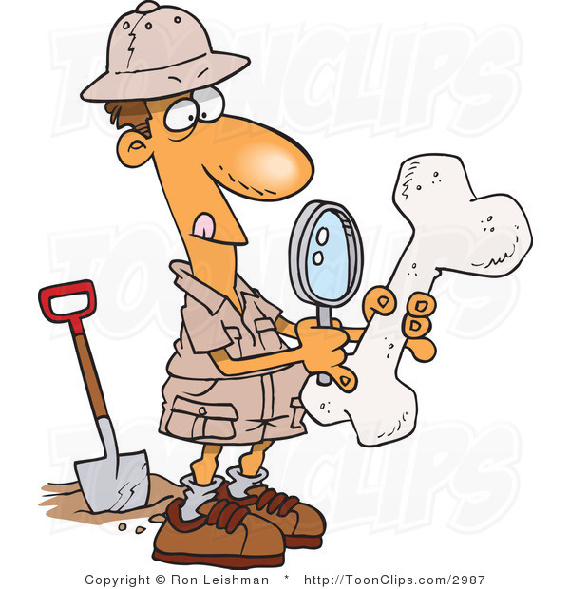
How Do We Know?!
Early Native Americans left no written records, so how do we know all of this?
Archaeologists study remains of early people and other artifacts to learn about early cultures,
Artifacts are human-made objects that give us clues about other cultures.
Many Native American groups have maintained oral histories and stories that are passed down through generations.

