Slide 1
The Great Depression & The New Deal

Slide 2
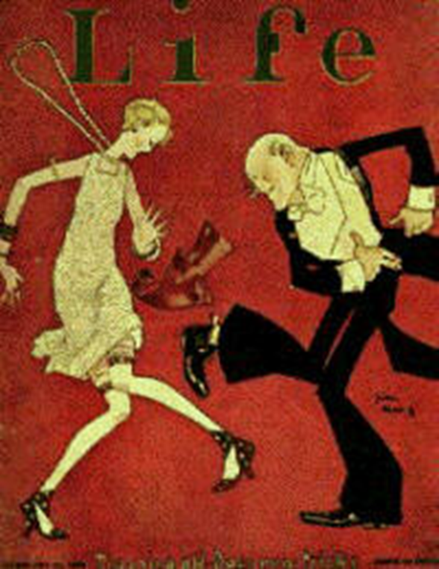
From Boom to Bust
After WWI, American Industry boomed.
U.S. became a major credit loaner to other nations in need.
Economy grew during the 1920’s.
Roaring 20’s.

Slide 3
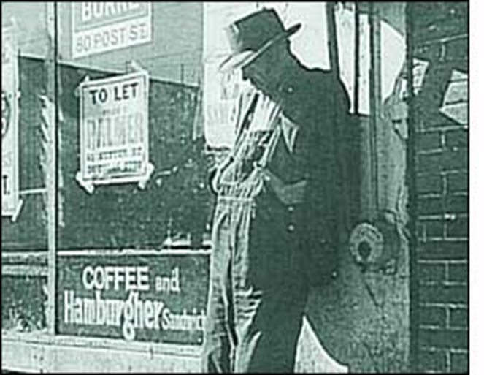
Weaknesses in the Economy
Many families still earned very little money.
Could only afford to buy new products on credit.
People began to go further into debt and could no longer make their monthly payments.

Slide 4
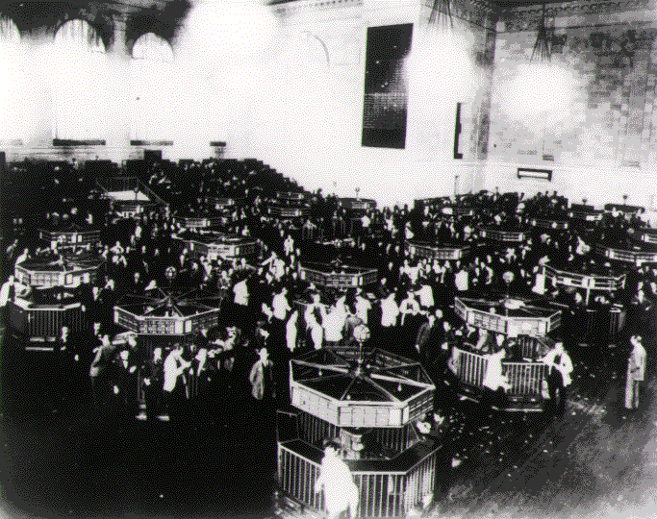
The Great Bull Market
People want to share in manufacturers profits by buying stocks.
Buy stocks on margin.
Problem: when stock values fall, people don’t have money to pay back the loan.

Slide 5
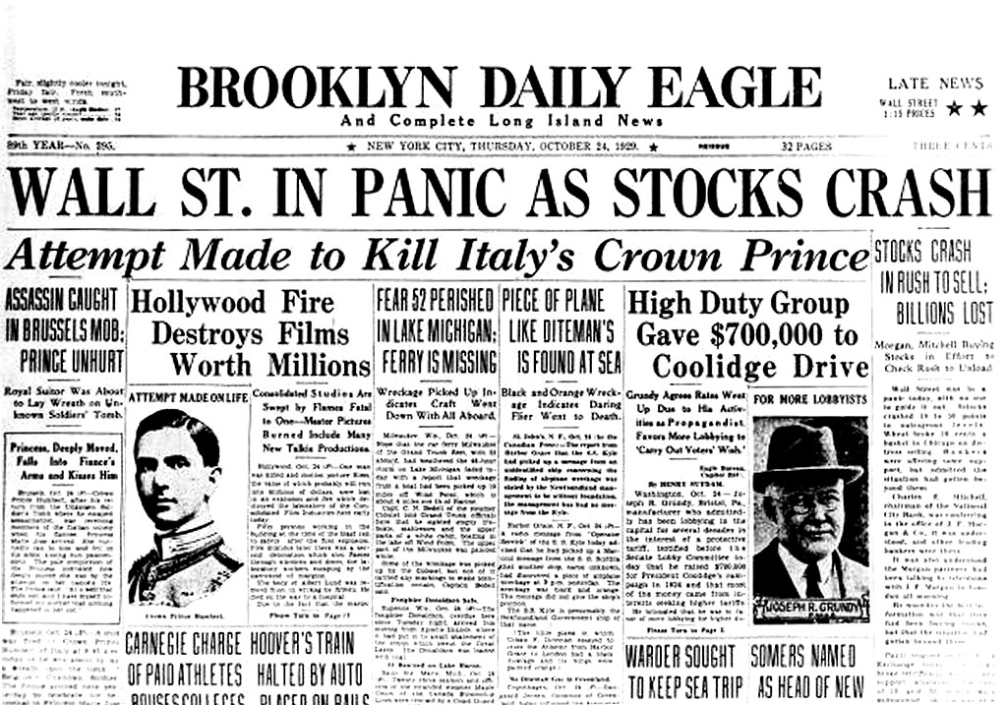
The Crash of 1929
Stock values begin to drop as companies profits decreased.
Everyone wants to sell their stocks quickly so they could pay their margins.
Stock priced drop dramatically.
On October 29th, the stock markets collapses
Black Tuesday

Slide 6
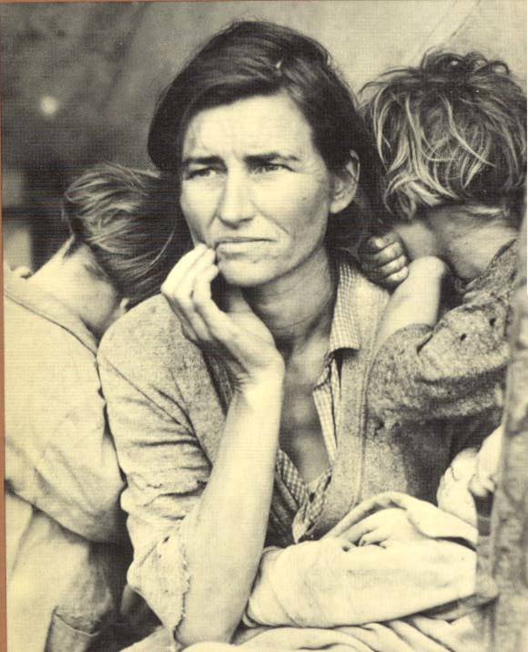
The Great Depression Begins
People want to withdraw their savings from the bank to pay the debt.
Banks have no money and many close.
People stop buying new goods and many businesses are forced to close.

Slide 7
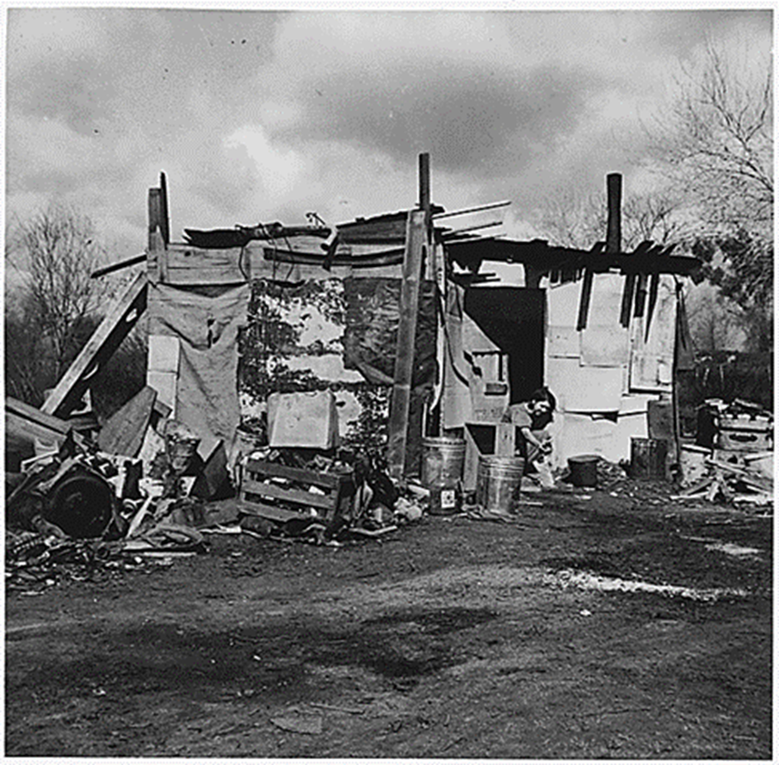
President Herbert Hoover
Makes small, unsuccessful attempts to help solve the nations problems.
Many of his solutions actually made problems worse.
Many people become homeless and form small clusters of shacks.
Hoovervilles

Slide 8
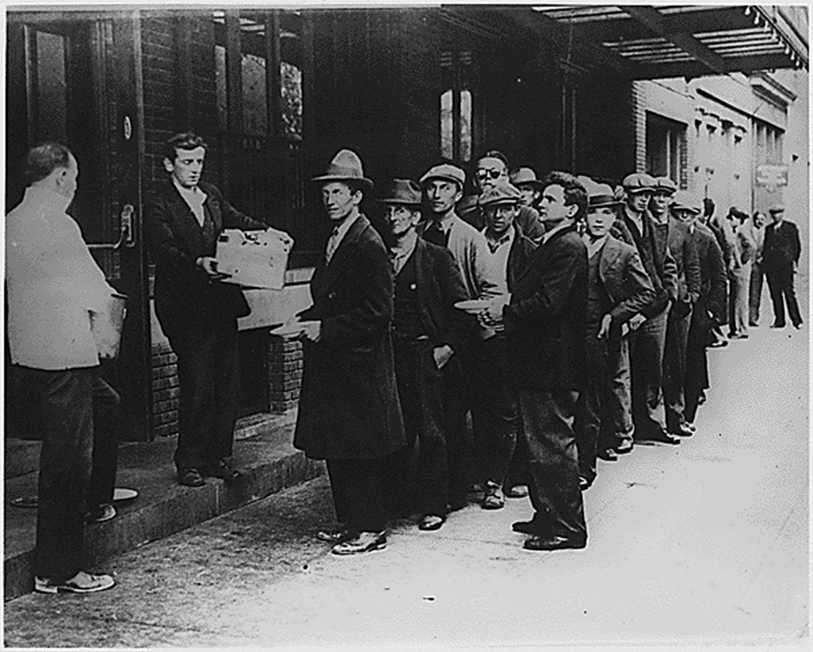
Effect on Americans
Farms foreclosed, no more luxuries, businesses shut down, banks closed and schools close.
Many people had to wait in long lines for bread to feed their families.

Slide 9
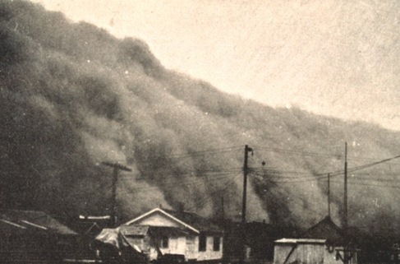
The Dust Bowl
A drought and over farming leads to a massive dust bowl.
Many houses were buried no crops were being produced.
Worst natural disaster of the 20th century.

Slide 10
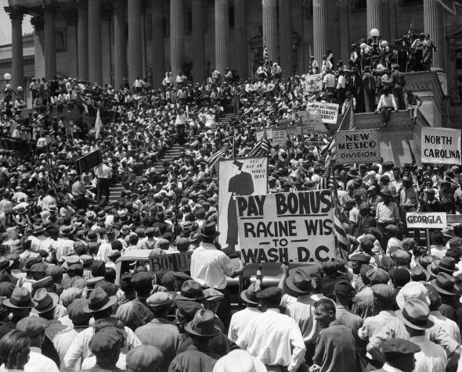
The Bonus Army
20,000 WWI Veterans march on Washington D.C demanding that they receive their bonus earlier than expected.
Hoover has U.S. Army remove them.
Causes people to hate Hoover even more.

Slide 11
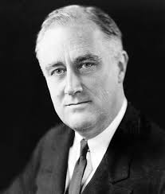
Franklin D. Roosevelt
Becomes president in 1932.
Pledges to tackle the problems caused by the Great Depression.
Became known as the New Deal.
Eleanor Roosevelt
First Lady
Fought for women's rights.

Slide 12
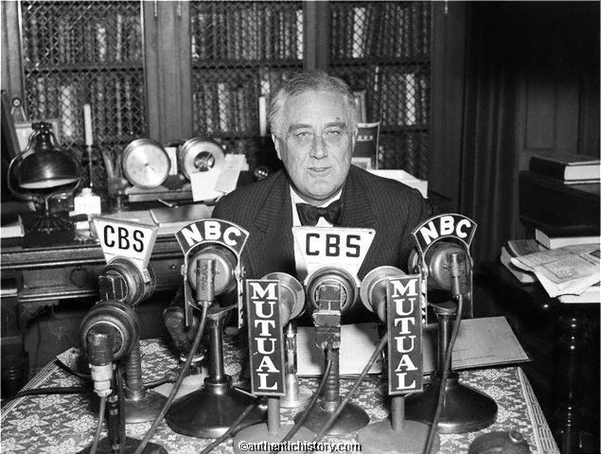
Roosevelt's New Deal
Believed that it was important to give home to Americans
Gave talks over the radio telling people that things would get better.
Fireside Chats
Closed the banks for 4 days.
“Bank Holiday” to restore hope in banks.

Slide 13
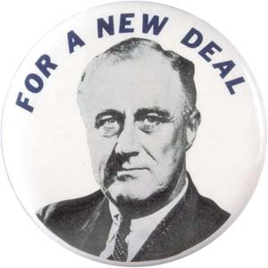
The Hundred Days
Roosevelt believed that it was the governments responsibility to help the needy.
Different from Hoover!
Calls a special session of congress in which a bulk of the New Deal programs were passed.
Goals: Relief, Recovery, Reforms.

Slide 14
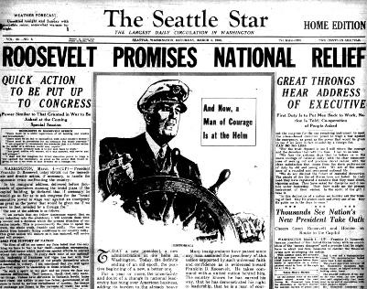
Social Security Act
Intended to help the elderly, laid off and disabled workers and needy with children.
Roosevelt runs for reelection
Many fear he will raise taxes more.
Wins election because working-class and African Americans support FDR.

Slide 15
Popular New Deal Programs
National Recovery Administration (NRA)
Regulated working conditions
Helped Industry recovery
Agricultural Adjustment Act
Improves situation for farmers.

