Slide 1
World War II
Unit 14

Slide 2
Unit 14 WWII Vocabulary
Dictator
Totalitarianism
Isolationism
Fascism
Adolf Hitler
D-Day
Holocaust
Battle of Midway
Hiroshima & Nagasaki
Japanese-American Internment
Benito Mussolini
Appeasement
Lend-Lease Act
Joseph Stalin
Winston Churchill
Franklin D. Roosevelt
Harry S. Truman
Dwight D. Eisenhower
Genocide
Manhattan Project
Island Hopping
Torpedo Junction
War Bonds
Axis Powers
Allied Powers
Rationing
Nuremburg Trials
United Nations
Marshall Plan

Slide 3
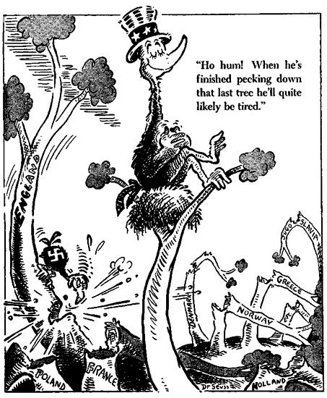
U.S. Foreign Policy
Following the devastation of WWI, most Americans favored isolationism.
Congress passes a series of Neutrality Acts.
Prohibit making loans or selling weapons to other countries.

Slide 4
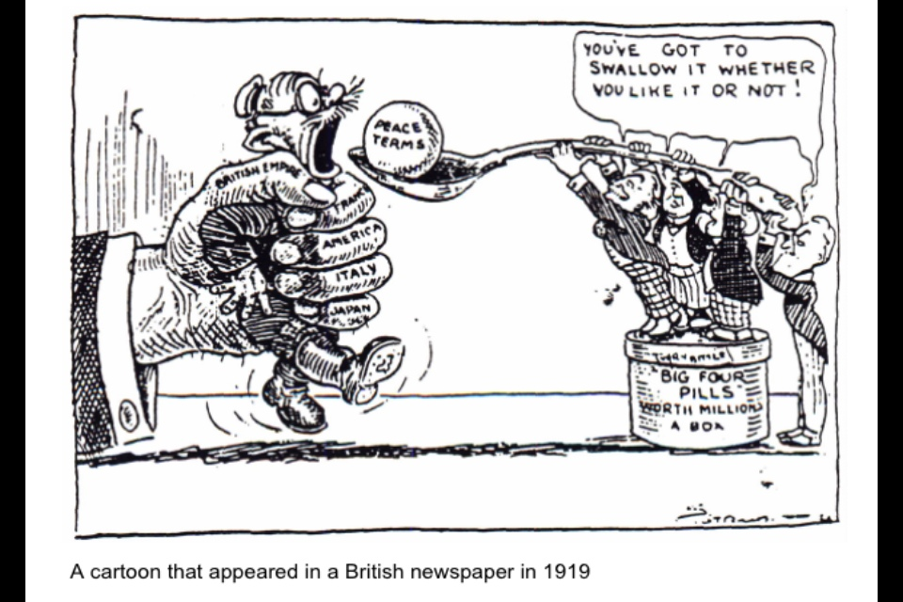
The Rise of Dictators
The Treaty of Versailles left many countries angry.
Japan and Italy felt ignored
Germany was punished severely for their role in the war.
Much of Europe is left heavily in debt as a result of the war and the Great Depression.
Many countries looked to new leaders to solve these problems.

Slide 5
Germany’s Economic Troubles
Germany owes $32 billion as a result of WWI.
Their government cannot pay that amount so they begin to print more money.
Causes hyperinflation.
The German Mark v. the U.S. Dollar
1914: $1 = 4 Marks 1921: $1 = 75 Marks 02/1923: $1 = 48,000 Marks 10/1923: $1 = 440,000,000 Marks (440 million) 11/1923: $1 = 4,200,000,000,000 Marks (4.2 trillion)

Slide 6
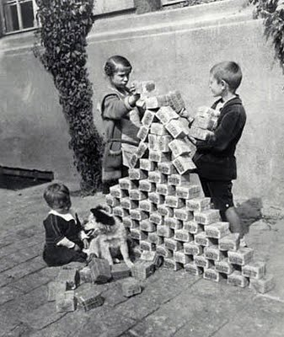
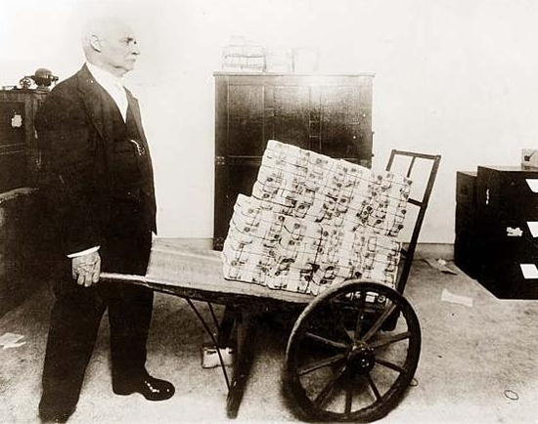
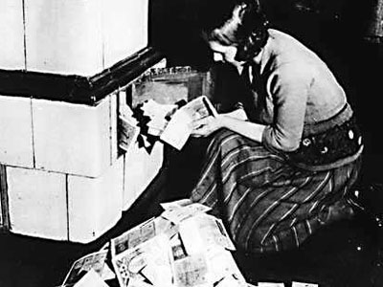
Inflation in Germany

Slide 7
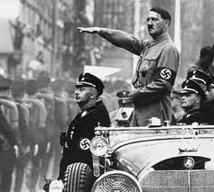
New Leaders Emerge
Benito begins a movement called fascism in Italy.
Takes power and establishes a dictatorship.
Adolf Hitler leads the Nazi Party to power in Germany.
Promises to avenge their defeat in WWI.
Vladimir Lenin leads the Communist Revolution in in the Soviet Union.
Joseph Stalin takes control after his death.

Slide 8
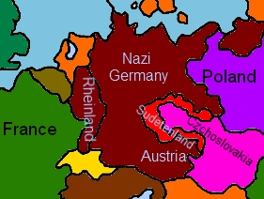
Dictators Expand their Territory
Japans military begins to take land in Asia and the Pacific to gain natural resources.
Italy attacks Ethiopia.
Germany moves troops into the Rhineland, which violates the Treaty of Versailles.
France and Britain do nothing.
Hitler and Mussolini sign an alliance.
Later becomes the Axis Powers.

Slide 9
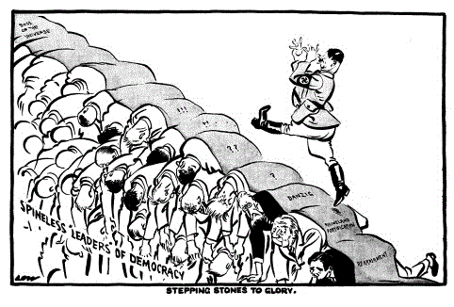
Germany Begins Conquest
Hitler demands the Sudetenland.
Part of Czechoslovakia with a large German population.
Britain and France adopt a policy of appeasement in order to avoid war.
Agree to allow Hitler to have the Sudetenland if he does not demand more land.

Slide 10
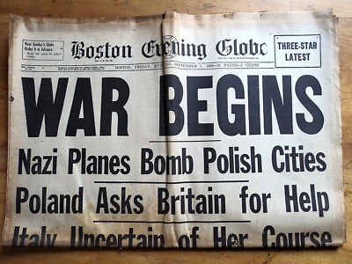
The War Begins
Hitler signs a Non-Aggression pact with the Soviet Union.
Agree not to fight each other.
Hitler plans to take the rest of Czechoslovakia and Poland.
They would split Poland with the Soviet Union.
Hitler invades Poland on September 1, 1939.
Britain and France declare war.

Slide 11
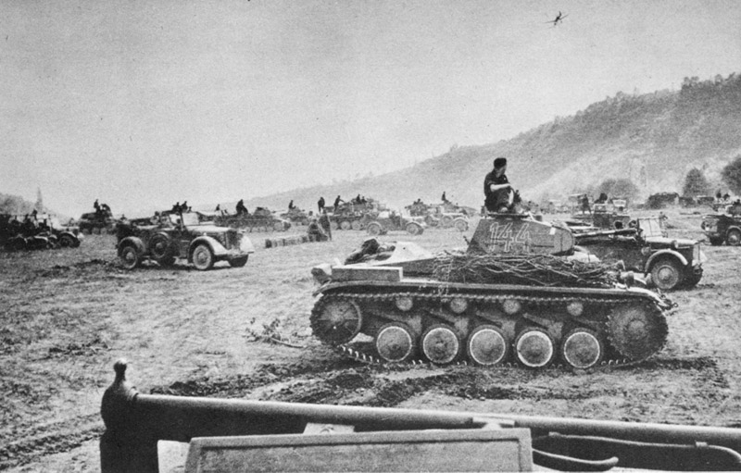
The Fall of Europe
Germany begins their tactic of quick, but devastating attacks.
Blitzkrieg
Germany conquers most of Europe, including France, very quickly.
Now look to conquer Britain.

Slide 12
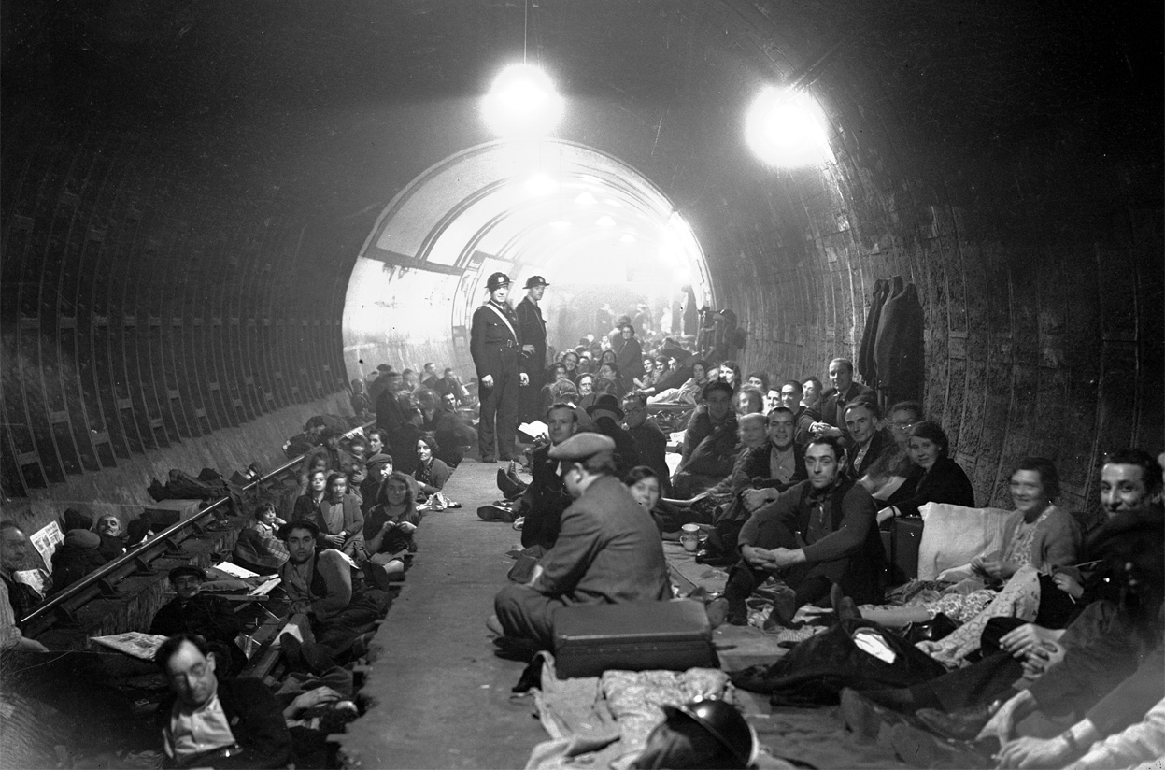
The Battle of Britain
The German Air Force, the Luftwaffe, battle with the Royal Air Force.
Germany is forced to halt its attack on Britain.
Germany continues to bomb Britain daily.

Slide 13
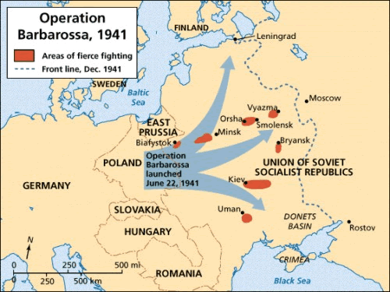
Germany attacks the Soviet Union
Germany wages Blitzkrieg and causes heavy casualties in the Soviet Union.
Climate causes major problems for Germany.
Extremely cold winters.
Germany is defeated at the Battle of Stalingrad.

Slide 14
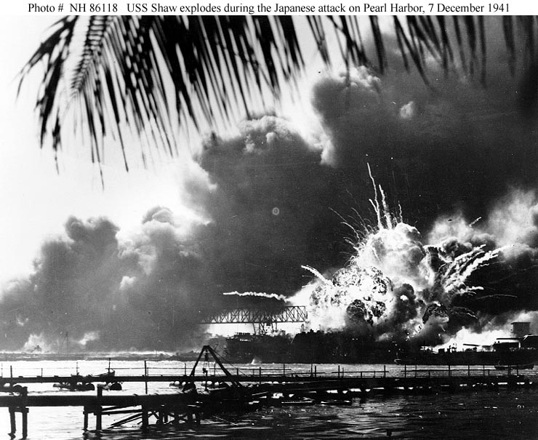
U.S. Involvement
Congress passes the Lend-Lease Act.
U.S. would lend raw materials, equipment, and weapons to Allied nations.
Japan bombs Pearl Harbor on December 7, 1941.
Roosevelt calls it “A day which will live in Infamy”
Hitler and Mussolini declare war on the U.S.

Slide 15
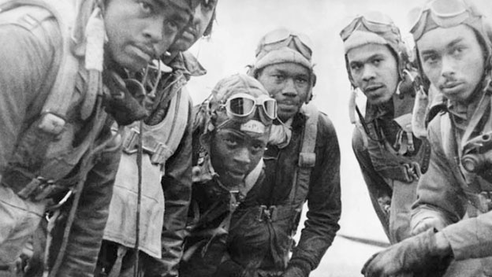
Mobilizing for War
Many Americans volunteer for duty, but millions more are drafted.
Selective Service Act requires all men between 18 and 38 to register for military service.
Many ethnic and racial groups are represented in the armed forces.
Many African Americans and Japanese Americans fought in segregated units.
Tuskegee Airmen.

Slide 16
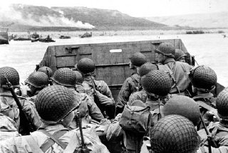
D-Day
On June 6, 1944, 5,000 Allied ships cross the English Channel to Normandy.
Led by Dwight D. Eisenhower
Allied forces storm the beaches and free Paris within a few months.
Germany is able to launch one final assault at the Battle of the Bulge, but are defeated and forced to retreat.

Slide 17
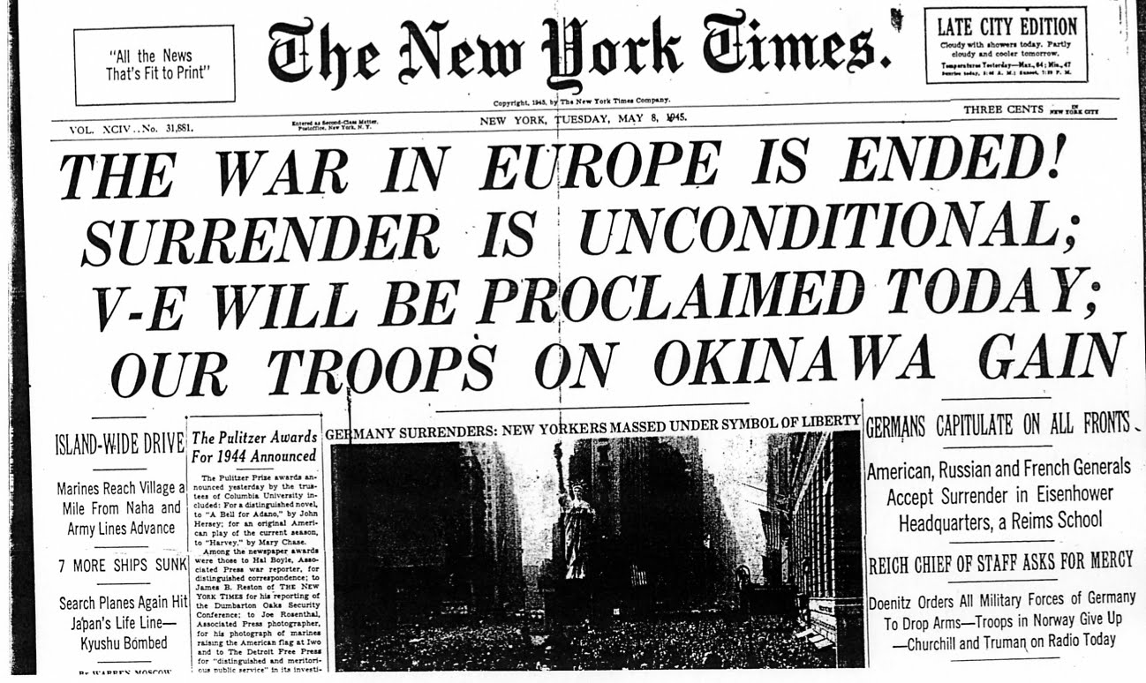
V-E Day
Allies forces reach Berlin and surround Hitler.
On April 30, 1945, Hitler commits suicide in an air raid bunker.
Five days later, German leaders surrender and the war ends.
Stands for Victory in Europe day.

Slide 18
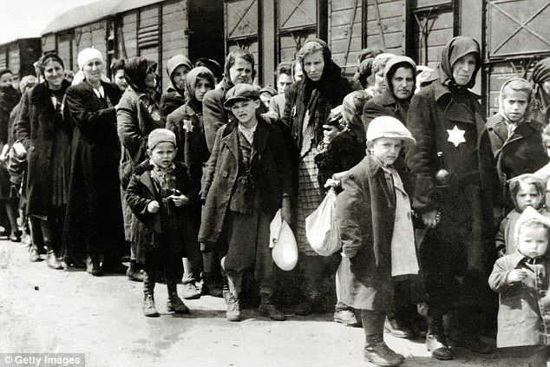
The Roots of the Holocaust
Hitler preached that other groups, particularly Jews, were inferior to Germans.
Blamed them for their economic problems.
Soon after the war begins, Hitler enacts his “Final Solution”
The goal was to exterminate all Jews (Genocide).
To accomplish this goal, huge concentration camps were built.
Able bodied people were forced to work, while everyone else was slaughtered.

Slide 19
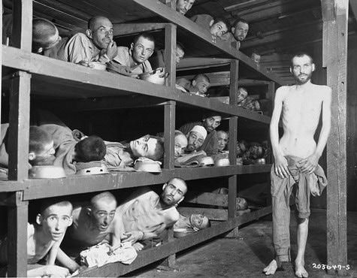
The Holocaust
Germans were able to kill hundreds of people at a time using gas chambers disguised as showers.
They would then burn the bodies in large ovens.
The largest concentration camp was Auschwitz in Poland.
More than 1 million people were murdered there.
In total, over 6 million Jews were killed in the concentration camps.
2/3 of the Jews in Europe.
Also killed millions of people of other ethnic groups.

Slide 20
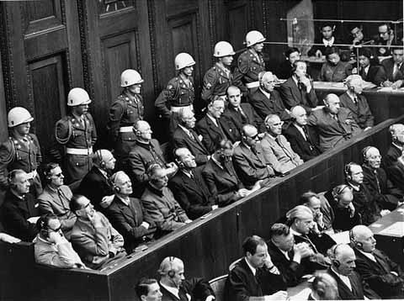
The Nuremburg Trials
As allied forces invade Europe, they discovered the concentration camps.
Nazi leaders were tried for the crimes against humanity
Nazi leaders claim that they were just following orders.
12 Nazi leaders were sentenced to death and were hung.

Slide 21
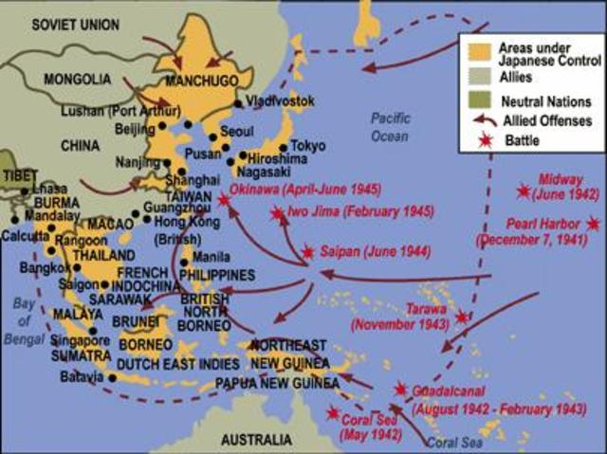
The War in the Pacific
Even though Germany had surrendered, the war against Japan continued.
Japan launched attacks throughout the Pacific.
Even attacked U.S. troops in the Philippines.
The U.S. turns the tide when they win the Battle of Midway.
The U.S. launches attacks on Japanese controlled islands throughout the Pacific, then stage attacks from captured islands.
Island Hopping.

Slide 22
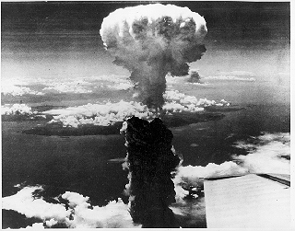
The Manhattan Project
Allies plan to invade Japan in 1945, but many leaders fear that and invasion will cost too many lives and money.
The U.S. sets up a top-secret program with the goal of creating an atomic bomb.
The Manhattan Project
Led by J. Robert Oppenheimer

Slide 23
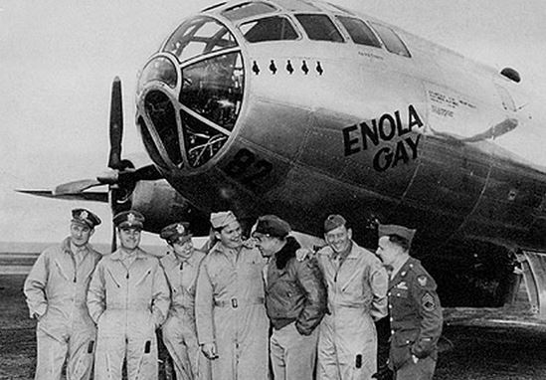
Dropping the Bomb
President Truman warns Japan that if they do not surrender, the U.S. will use atomic weapons.
Japan refuses
On august 6, 1945, the Enola Gay drops an atomic bomb on the city of Hiroshima.
Instantly kills 70,000 people.
Japan still won’t surrender.
On August 9, Truman orders a second bomb to be dropped on Nagasaki.
Kills another 40,000
Japan Surrenders (V-J Day)

Slide 24
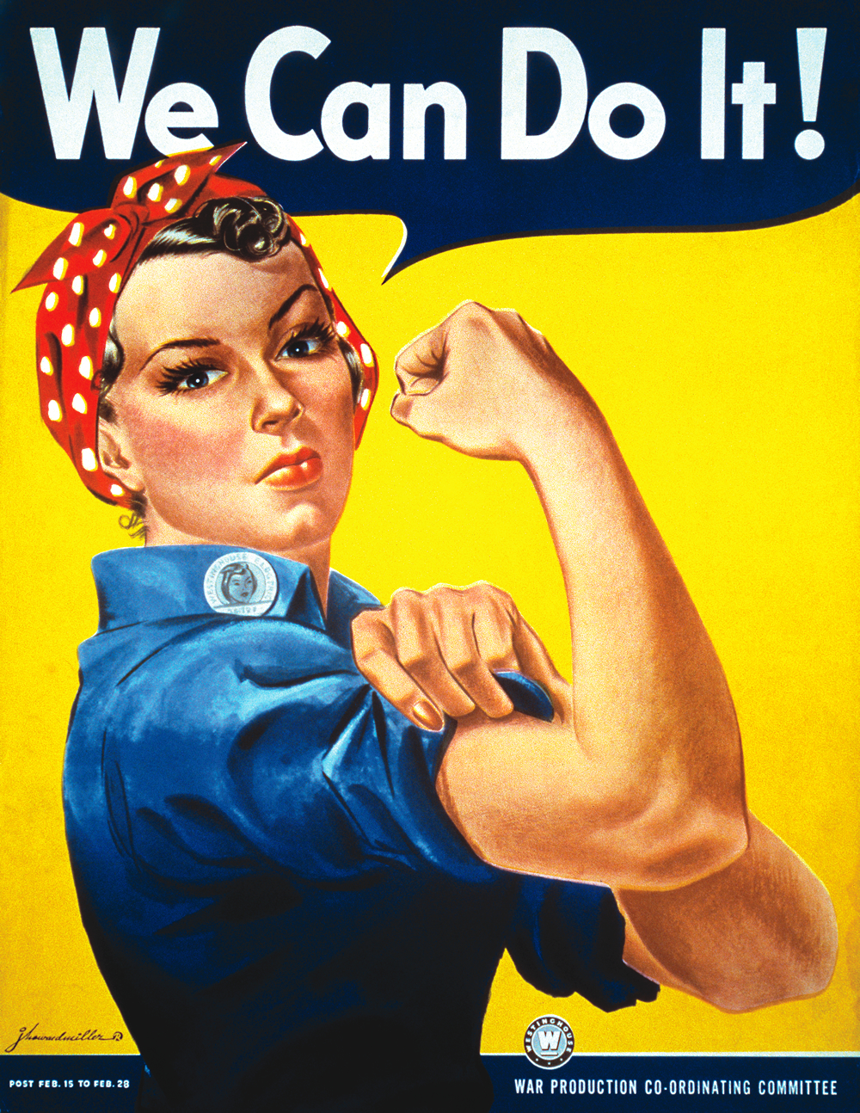
The Home Front
Under the guidance of the War Production Board, U.S. factories began churning out massive amounts of supplies for the war.
With so many factories in need of workers, jobs became available.
The war helps to end the Great Depression.
With many men fighting overseas, the demand for women and minority workers increased.
Rosie the Riveter

Slide 25
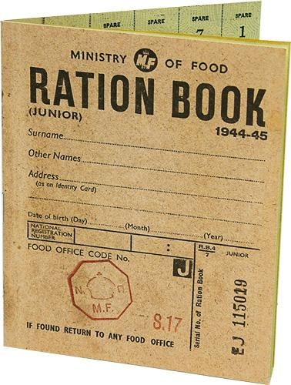
The Home Front Cont.
Because so many materials were needed to support the war effort, many items became scarce (gasoline, food, clothing etc.)
To divide these materials evenly, families received fixed amounts of certain items.
Rationing
To help pay for the war, the government raised income taxes and sold war bonds.
Loans that the government would pay back with interest.

Slide 26
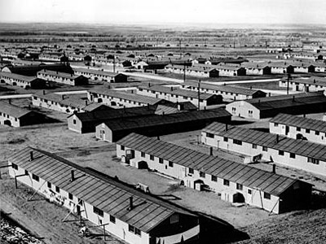
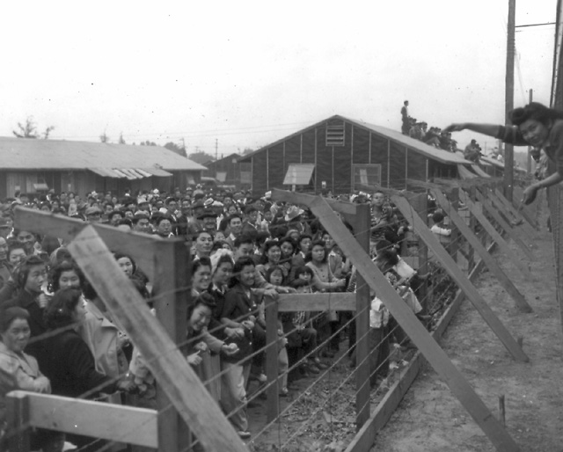
The Internment of Japanese Americans
After Pearl Harbor, several newspapers declared Japanese Americans to be a security threat,
President Roosevelt signs an order that allowed people of Japanese ancestry to be removed from the Pacific Coast.
More that 110,000 citizens were placed in internment camps.
They had to sell their houses and leave their jobs.

Slide 27
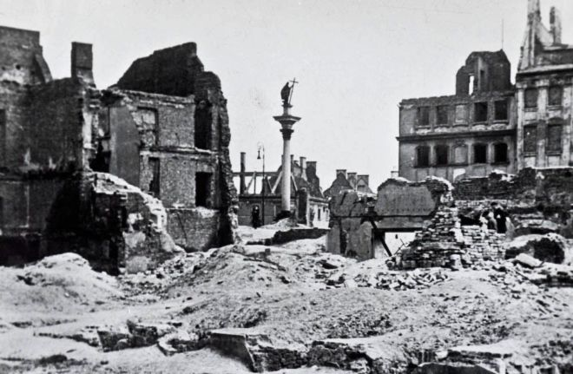
Legacy of the War
About 20 million soldiers are killed and millions more wounded.
Many of the worlds economies and infrastructure (roads, buildings, factories, etc.) were left in ruins.
Except the U.S.
Congress approves the Marshall Plan which allows the U.S. to give more than $13 billion to help European nations.

Slide 28
Legacy of the War Cont.
The war demonstrated the need for countries to work together to secure world peace.
The peacekeeping body known as the United Nations is created.
Similar to the League of Nations except the U.S. joins.
When the war ends, the United States and the Soviet Union emerge as superpowers.
Though allies in WWII, these countries distrust each other.

Slide 29
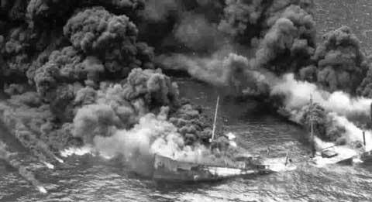
The Wars effect on NC
The waters off Cape Hatteras became known as Torpedo Junction because of German submarine activity.
By the end of the war, more U.S. soldiers had been trained in North Carolina than any other state.
Fort Bragg, Camp Davis.

