Slide 1
The Cold War
Unit 15

Slide 2
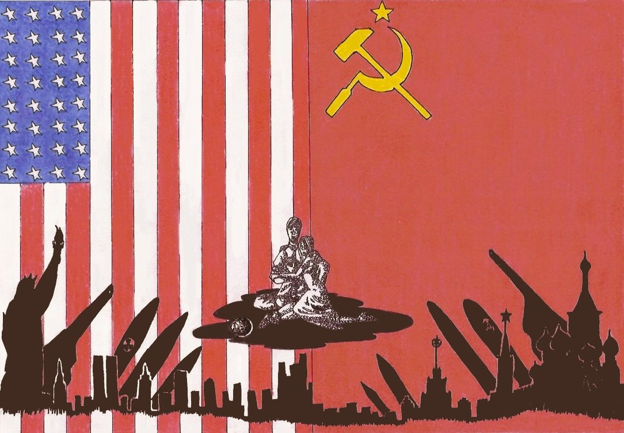
Beginning of the Cold War
At the end of WWII, much of Europe is destroyed, but two superpowers emerge.
United States and the Soviet Union
Both countries have very different economic and political systems, which leads to distrust and conflict.
Democracy V. Dictatorship
Capitalism V. Communism

Slide 3
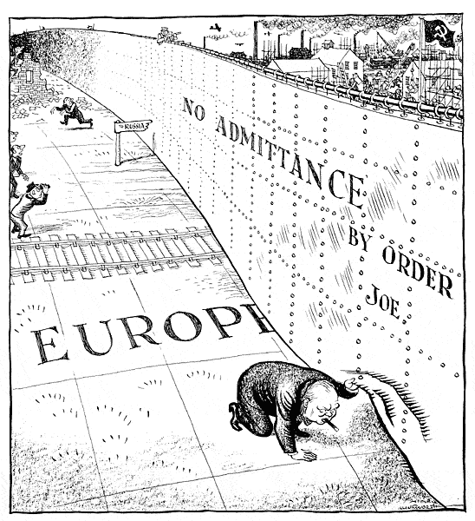
The Iron Curtain
When WWII ends, Communists take control of the governments of many Eastern European countries.
These countries have close political and economic links to the Soviet Union.
Become known as satellites because they depend on the Soviet Union like planets depend on the sun.
Winston Churchill refers separation of Communist and non Communist countries as an “Iron Curtain”.

Slide 4
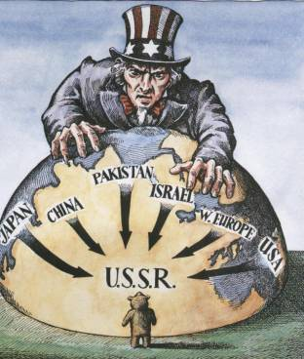
Containing Communism Abroad
Fearing that Stalin would attempt to spread communism worldwide, President Truman adopts a policy of containment.
The goal was to use military and non military ways to stop the spread of communism.

Slide 5
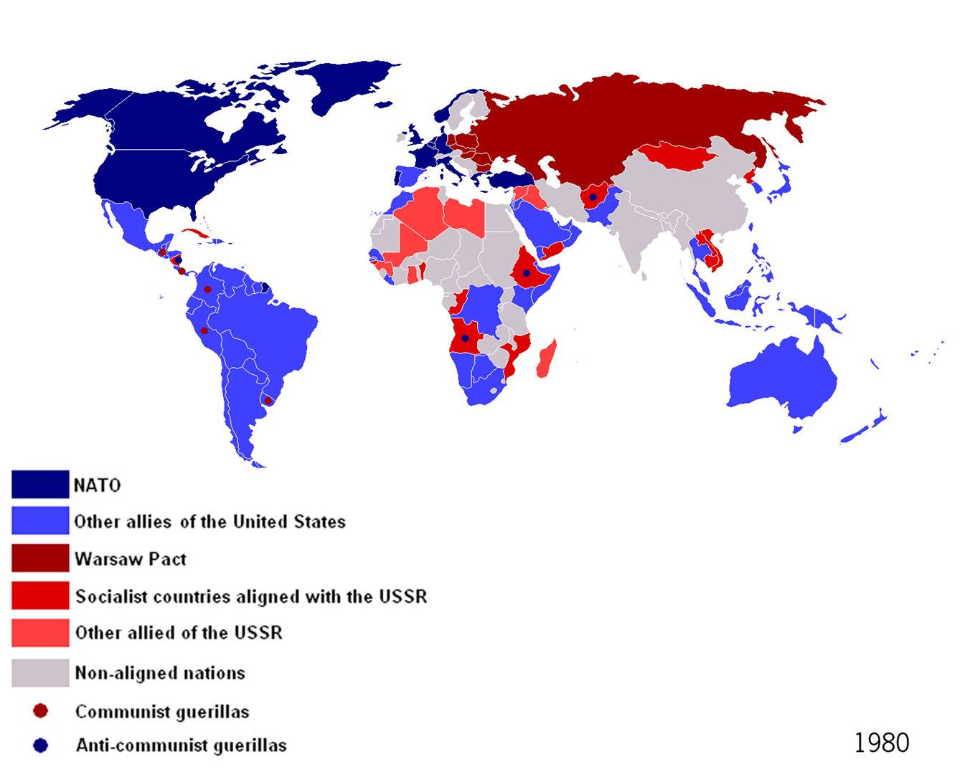
Military Alliances
In 1949, non-communist countries organize the North Atlantic Treaty Organization.
NATO
The NATO nations agreed to treat an armed attack on one member as an attack on all.
In response, many Communist countries announce its own alliance called the Warsaw Pact.

Slide 6
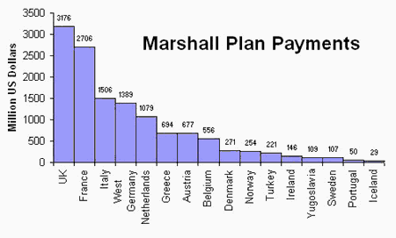
The Marshall Plan
The United States was concerned that the Soviet Union would continue to spread communism into war-torn countries in Europe.
They come up with the Marshall Plan, which offered $13 billion to Western European countries to help them rebuild from the war.

Slide 7
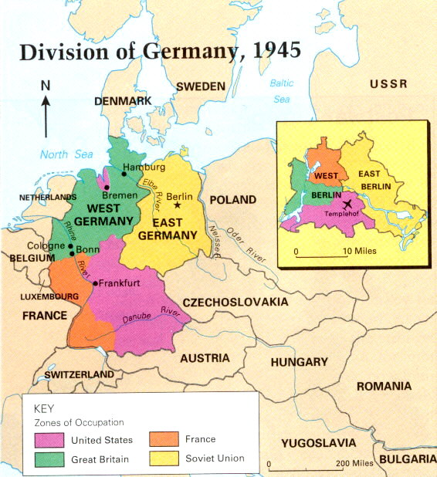
Crisis in Germany
Western Powers and the Soviet Union could not agree on how to set up a unified German government.
France, Great Britain, the U.S., and the Soviet Union divide Germany into four zones.
France, G.B., and the U.S. merge their zones into West Germany.
Berlin lies within the eastern zone controlled by the Soviet Union.
Berlin was also divided into East and West Berlin

Slide 8
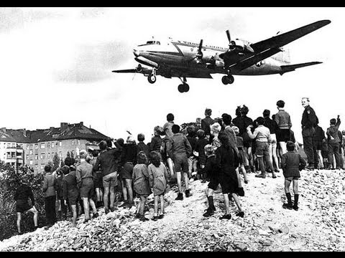
The Berlin Airlift
In an attempt to force Western powers to abandon Berlin, Stalin’s forced blocked access to the city.
With no supplies able to get to the city, citizens of West Berlin faced starvation.
President Truman approves an airlift that would allow cargo planes to fly food, coal and other supplies into Berlin.
Lasts for 11 months.
Stalin is forced to call off the blockade.

Slide 9
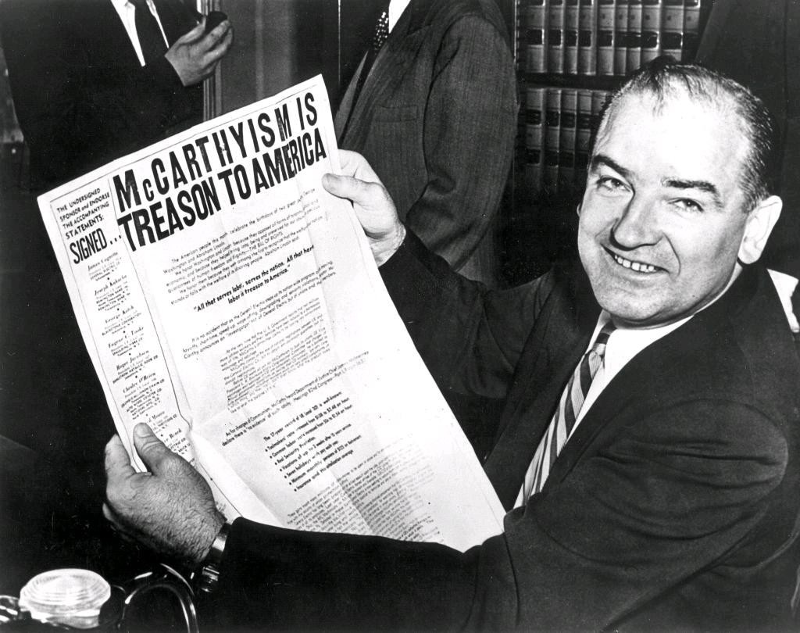
Fear of Communism at Home
After WWII, a growing number of Americans feared that communism would gain strength in the United States.
Senator Joseph McCarthy made claims that hundreds of people working in the government belonged to the communist party.
He had no evidence.
Fearful of employing communists, many organizations carried out “witch hunts” of their own.
This led to many people losing their jobs.
McCarthyism

Slide 10
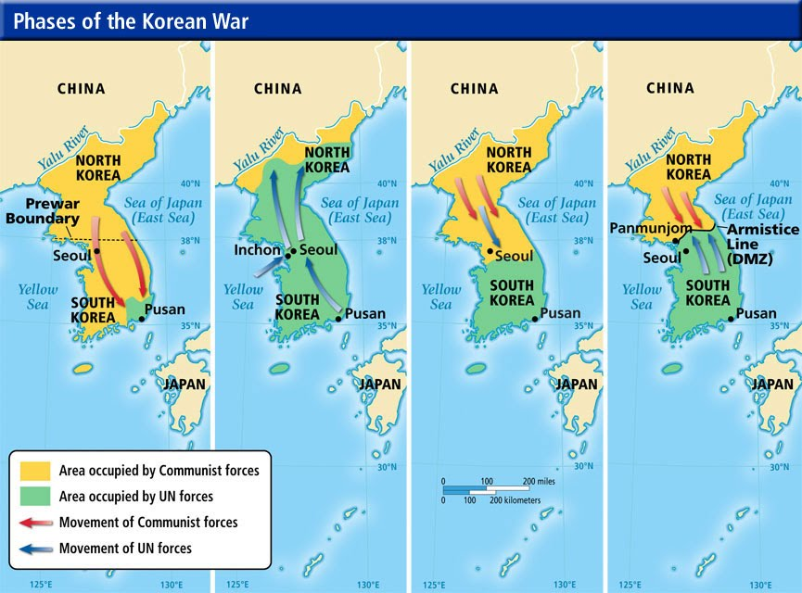
The Korean War
After WWII, Korea was split at the 38th parallel.
The United States occupied the south, while the Soviet Union occupied the north.
North Korea invades South Korea in 1951 and is able to push UN soldiers to the southern tip of Korea.
U.S. soldiers led by Douglas MacArthur push the North Koreans past the 38th parallel towards the border of China.
More than 200,000 Chinese soldiers enter North Korea and push the UN armies past the 38th parallel.

Slide 11
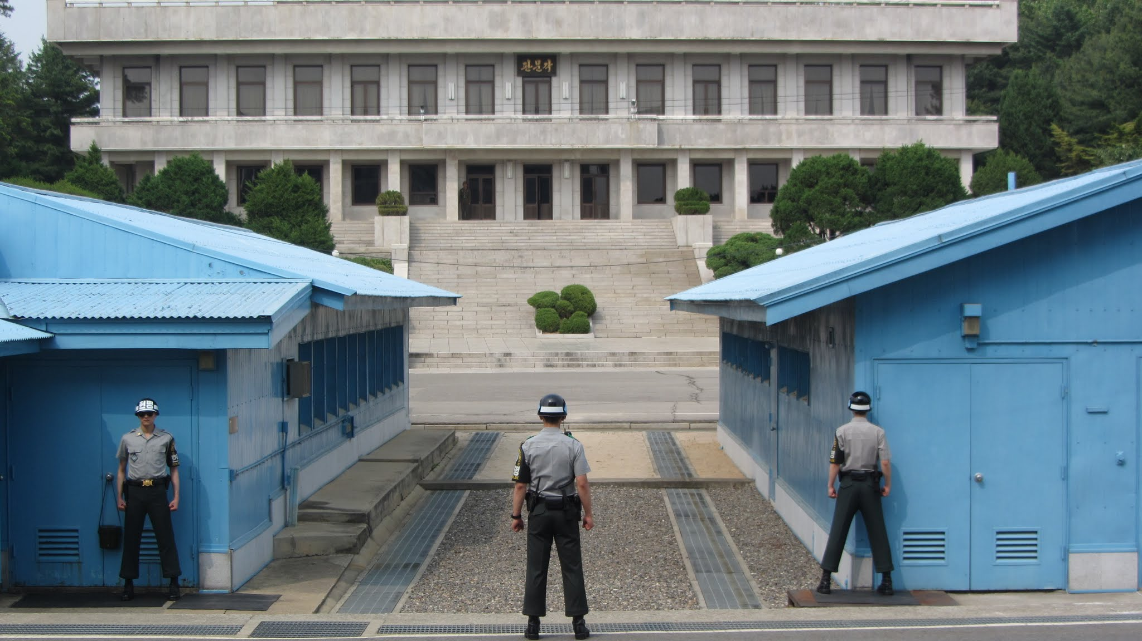
The Korean War Cont.
MacArthur wants to bomb China, but Truman doesn’t want to start a war with China and risk involving the Soviet Union.
Truman fires MacArthur.
A cease-fire is signed in 1953.
Neither side gained any ground.
A 2 ½ mile wide demilitarized zone (DMZ) is formed along the 38th parallel.

Slide 12
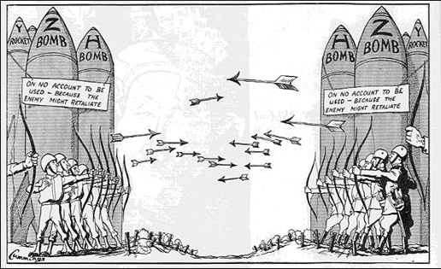
U.S.-Soviet Relations
After seeing the U.S. use an atomic bomb, the Soviet Union knew they had to develop their own in order to compete.
The U.S. responds by building a more powerful hydrogen bomb.
The Soviet Union follows by building their own hydrogen bomb,
Fear led both sides to build up huge stockpiles of nuclear weapons.
Arms Race

Slide 13
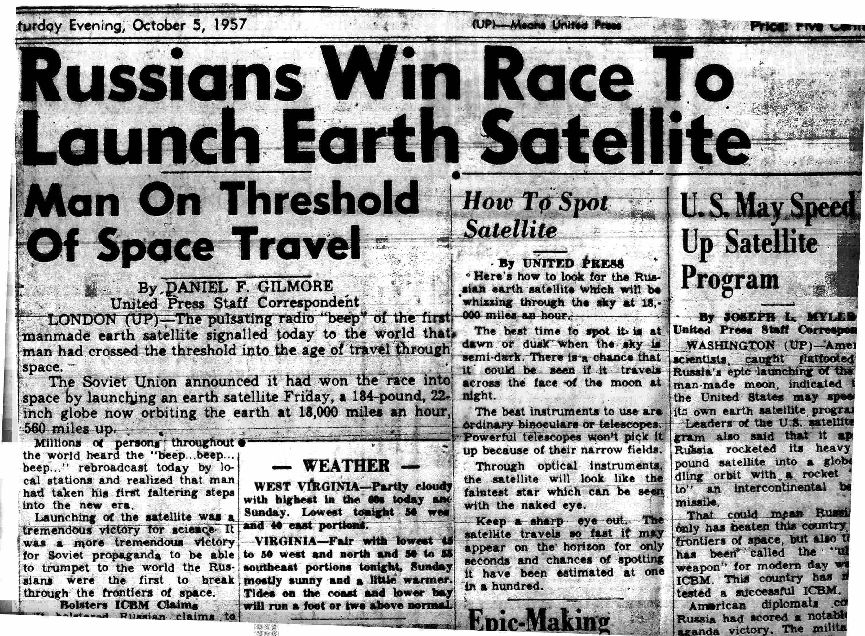
U.S-Soviet Relations Cont.
In 1957, the Soviet Union shocked the world by launching the first satellite into space.
Sputnik
This meant that the Soviet Union had developed a missile that could reach the U.S., so they spent billions of dollars to launch their own satellite.
Space Race

Slide 14
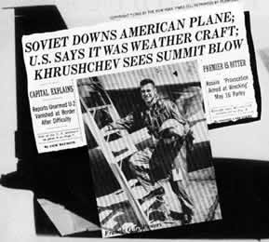
U.S.-Soviet Relations Cont.
In 1960, President Eisenhower (U.S.) and Premier Nikita Khrushchev plan to meet face to face.
Two weeks before the meeting, the Soviets shot down an American U2 (spy plane).
Eisenhower denied that it was a spy plane, but the pilot was captured and the U.S. admitted to using such planes.
Khrushchev broke off the meeting.

Slide 15
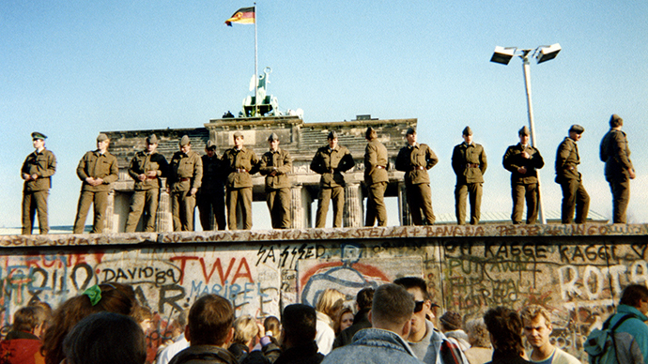
Kennedy Faces Communist Threats
In 1961, Kennedy approves an invasion of Cuba to overthrow the country’s communist leader, Fidel Castro.
The invasion was led by an army of exiled Cubans that were trained by the U.S.
They land at the Bay of Pigs and are quickly defeated.
The Soviet Union builds the Berlin Wall to prevent East Germans from fleeing.
Becomes a symbol of Communist oppression.

Slide 16
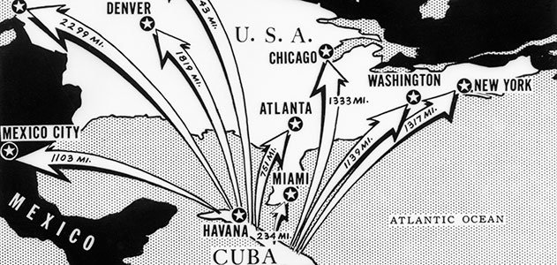
Cuban Missile Crisis
In 1962, photographs taken by U.S. planes show missiles capable of carrying nuclear warheads to the U.S. in Cuba.
Kennedy orders a blockade around Cuba and demands that all existing weapons be dismantled and removed.
The Soviet Union agrees to do so if the U.S. lifts the blockade and doesn’t invade Cuba.
The U.S. also dismantles weapons aimed at the USSR

Slide 17
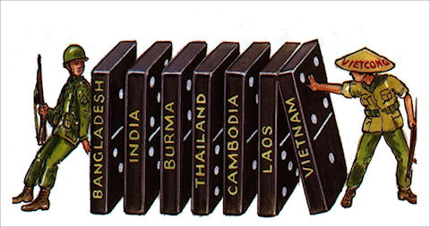
Unrest in Vietnam
After France gave up its colony of Vietnam, the country split in half at the 17th parallel.
North Vietnam is controlled by the Communist leader Ho Chi Minh.
South Vietnam is anti-communist and is supported by the U.S.
The U.S. fears that if one country is Southeast Asia falls to communism, the surrounding countries will do the same.
Domino Theory.

Slide 18
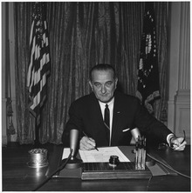
U.S. Involvement in the Vietnam War
In 1964, two U.S. destroyers reported that North Vietnamese gunboats fired at them in the Gulf of Tonkin.
President Lyndon B. Johnson asks congress to pass the Gulf of Tonkin Resolution, which would give the president power to use military force in Vietnam.
Johnson sends thousands of troops into Vietnam and bombs strategic targets.

Slide 19
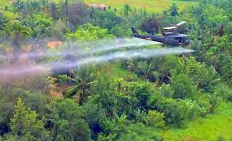
A Frustrating War
Many Americans thought that since they had superior weapons, the war would be over very quickly.
Viet Cong relied on guerilla warfare, which made them very difficult to defeat.
American soldiers couldn’t always tell who was an enemy and who was a civilian.
The land and the climate also made it a difficult to fight a war.
Thick jungles.
Extremely hot and humid.
Rained constantly.

Slide 20
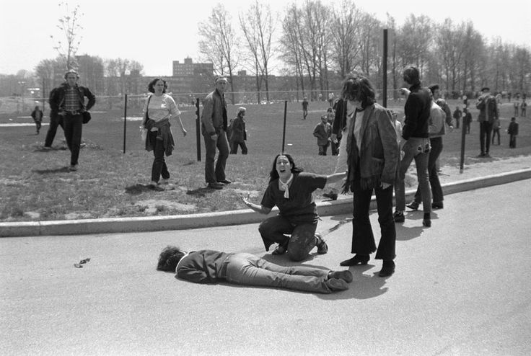
An Unpopular War
By the mid 1960’s, many Americans began to oppose the war.
Doves- opposed the war
Hawks- supported the war
President Richard Nixon announces his strategy of Vietnamization.
Gradually withdrawing U.S. troops and turning the fighting over to the South Vietnamese.
In 1970, students at Kent State University protested the war.
Nixon ordered the National Guard to break up the protest.
They opened fire, killing four students.

Slide 21
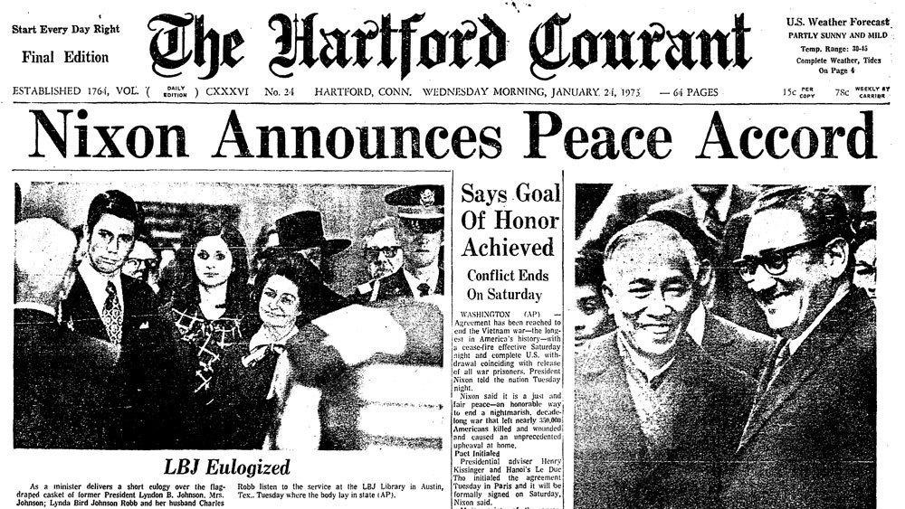
Legacy of the War
On January 27, 1973, the U.S. and South Vietnam made a peace agreement with North Vietnam.
Vietnam later unites under Communist control.
The 26th Amendment is passes, lowering the voting age from 21 to 18.
Congress passes the War Powers Act.
Limits the president’s war-making power.

Slide 22
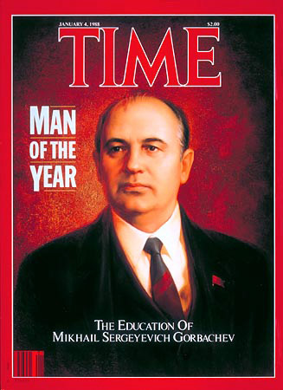
Gorbachev Initiates Reform
Mikhail Gorbachev becomes the leader of the Soviet Union in 1985.
Enacts his policies known as perestroika and glasnost.
Allowed for greater freedoms in Soviet society.

Slide 23
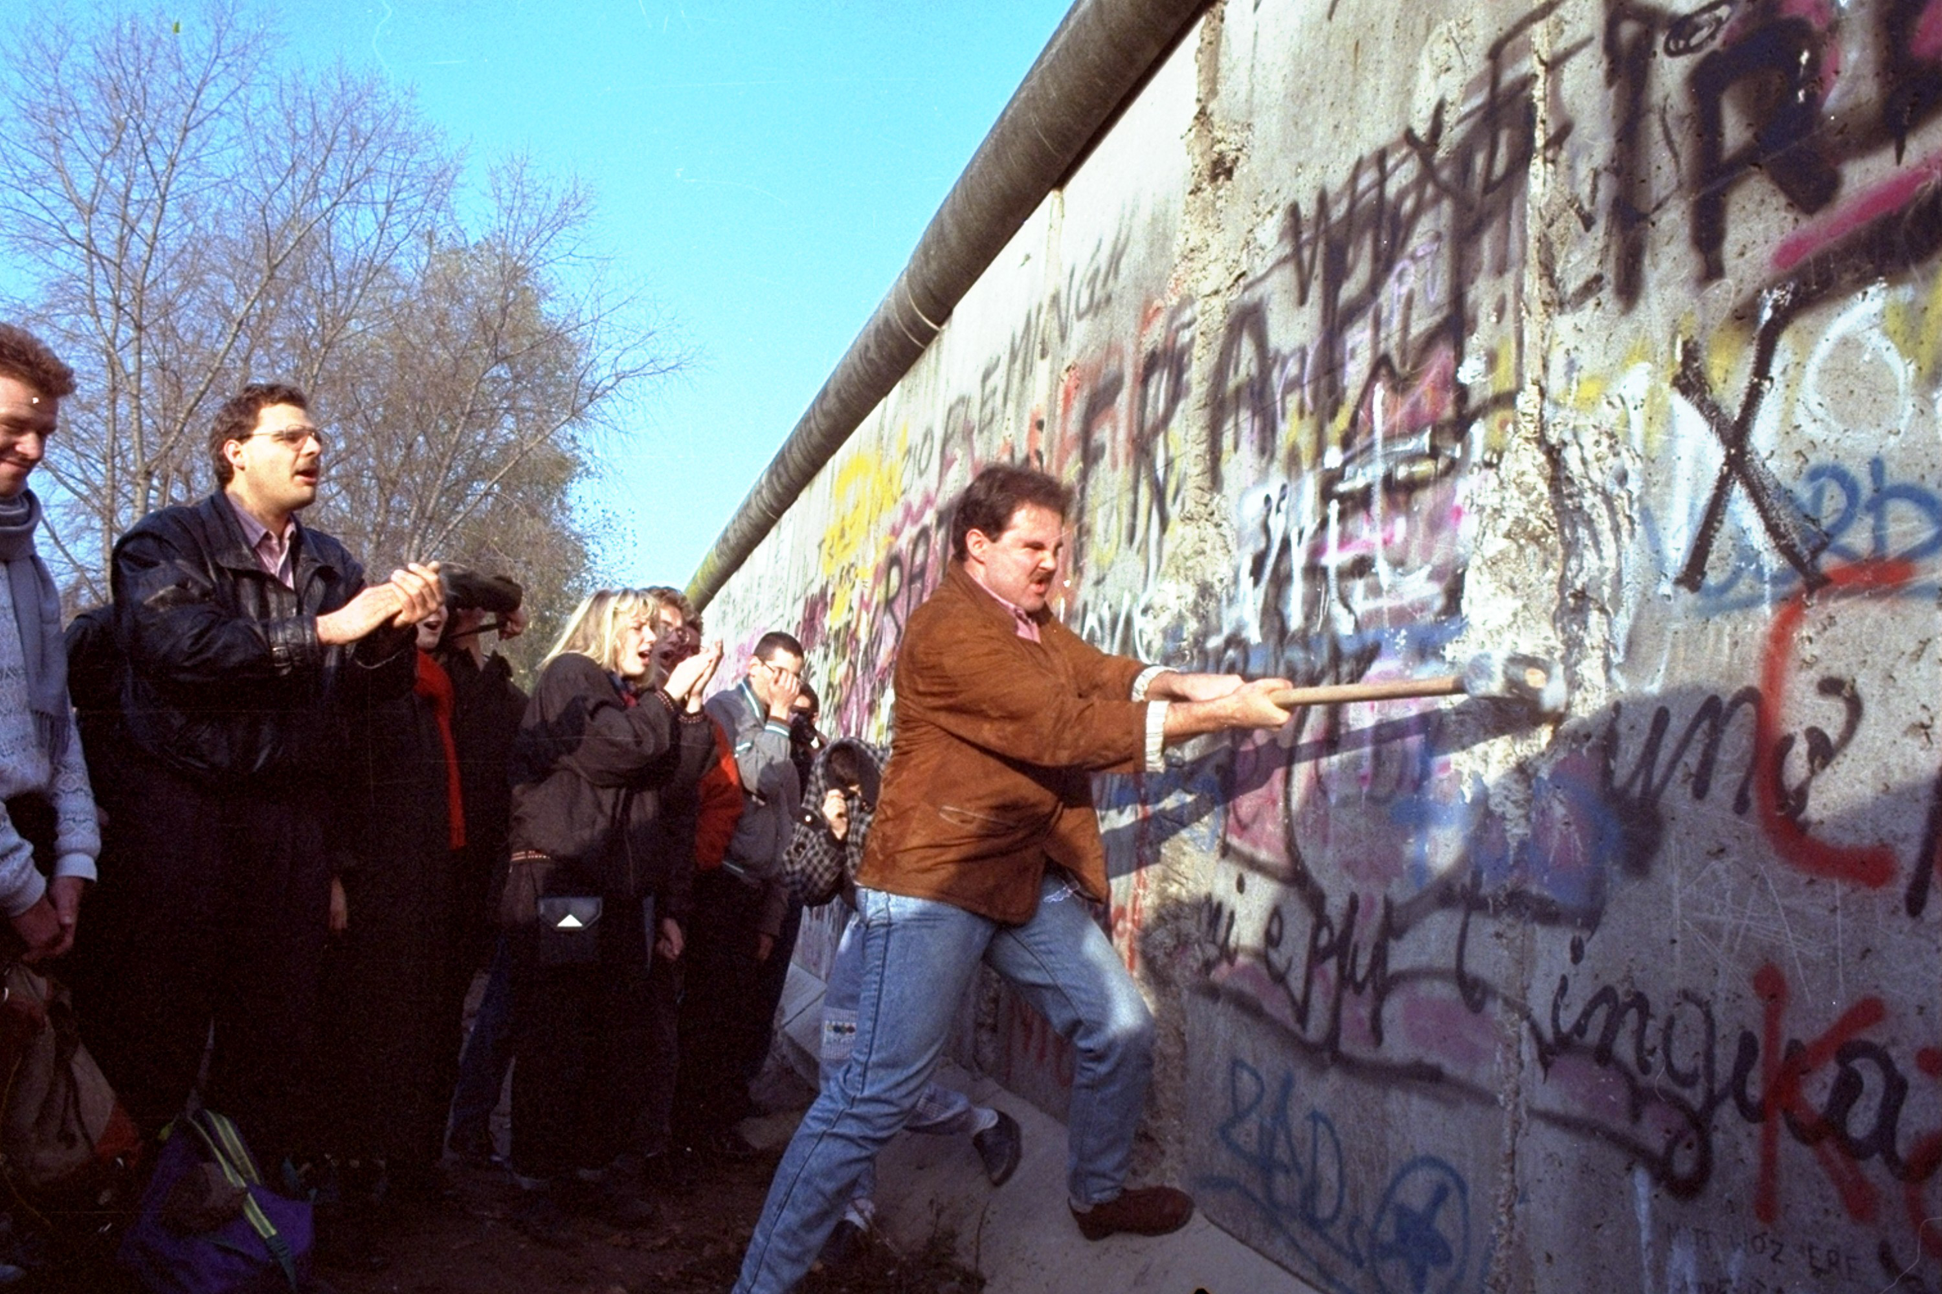
The Cold War Ends
In 1989, East Germans protest against their Communist government.
On November 9th, the Berlin wall is taken down.
East and West Germany are later united.
In 1991, Gorbachev resigns and the Soviet Union is disbanded, signaling the end of the Cold War.

