Slide 1
European Exploration of North America and North Carolina
Chapter 3

Slide 2
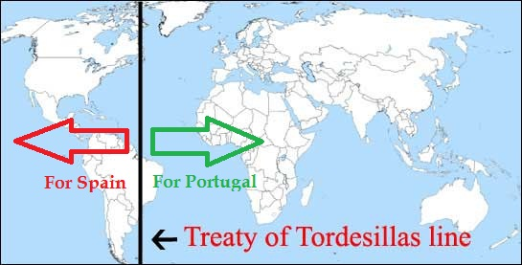
Dividing the World
Spain and Portugal were the main European countries exploring the seas.
To avoid claiming the same lands, they signed the Treaty of Tordesillas.
Split the world in half and allowed Spain to claim all lands to the west and Portugal to claim lands to the east.
Spain can claim Americas
Portugal claims valuable lands in Africa and Asia.

Slide 3
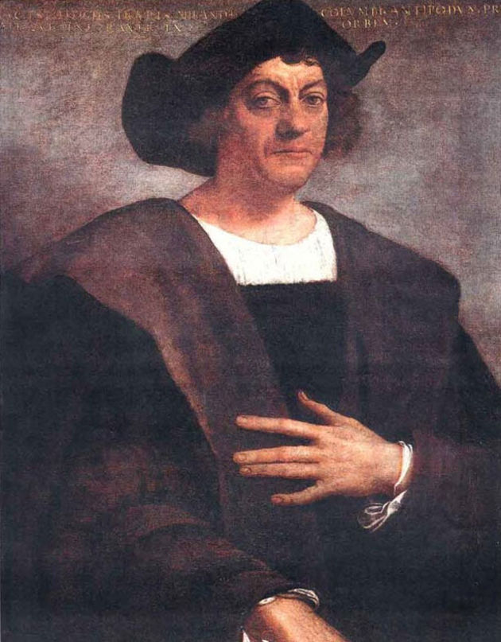
Christopher Columbus
Queen Isabella and King Ferdinand of Spain fund Columbus’ expedition to find an all sea route to Asia.
Establishes Spain’s first Settlements in America on the Caribbean Islands in 1492.
Columbus never realizes that he did not reach Asia.
Forced the Natives to work the land to make a profit.
Taught them Christianity in return.

Slide 4
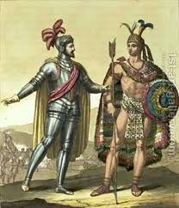
Voyages continue
Spain sends more explorers known as conquistadors.
Hernando Cortez sails to present-day Mexico in 1521 and conquers the Aztec Empire.
Francisco Pizarro sails to Peru and conquers the Inca Empire.
Superior technology made the conquests very easy and made Spain very rich.

Slide 5
Missionaries Spread Catholicism
Aside from finding gold, spreading Catholicism was the main goal of the explorers.
Catholic priests came to America as missionaries.
Established towns the consisted of a church, a fort, and homes.
Called missions

Slide 6
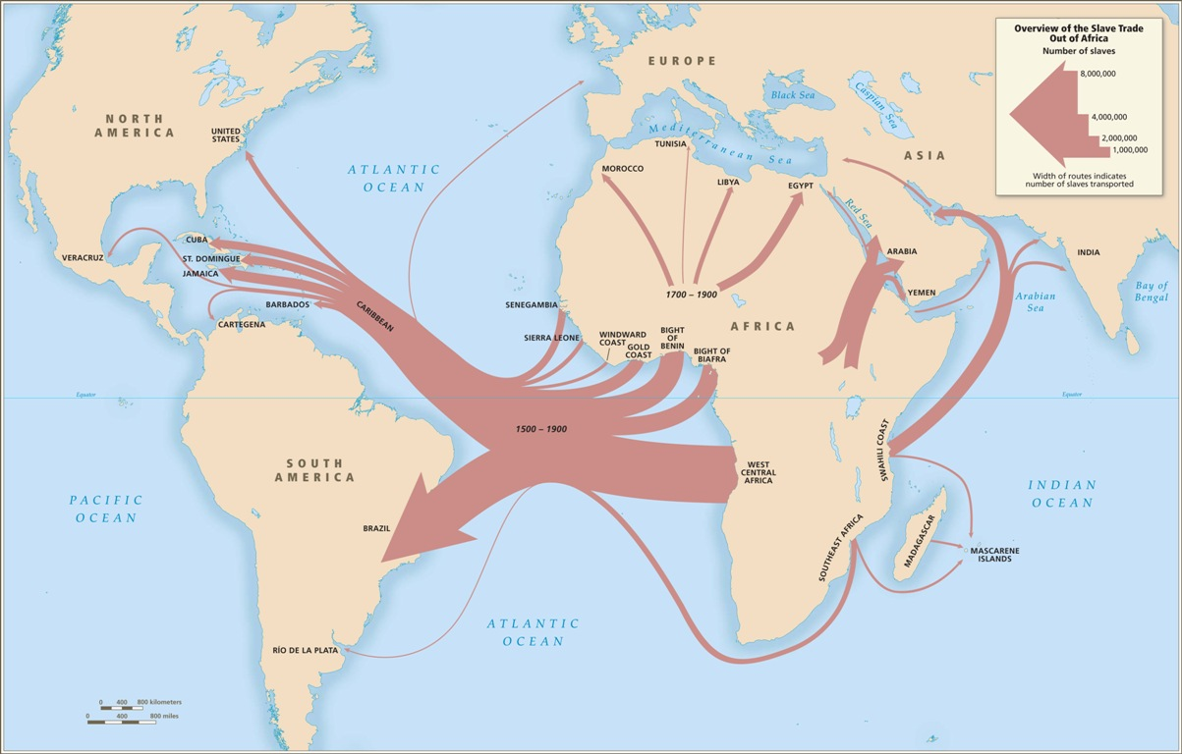
The Slave Trade
In the 1500’s, Portugal explored Africa in search of gold, but quickly realized that enslaved Africans were valuable.
Due to the increased demand for labor in the New World.
They began to buy slaves from African chiefs and shipping them to the Americas.

Slide 7
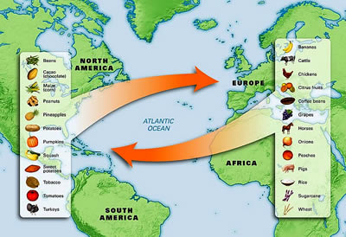
The Columbian exchange
The movement of plants, animals and disease between the Eastern and Western hemispheres.
Native Americans did not have immunity to European diseases, so many died.
Historians estimate that more than 20 million Natives died from disease.

Slide 8
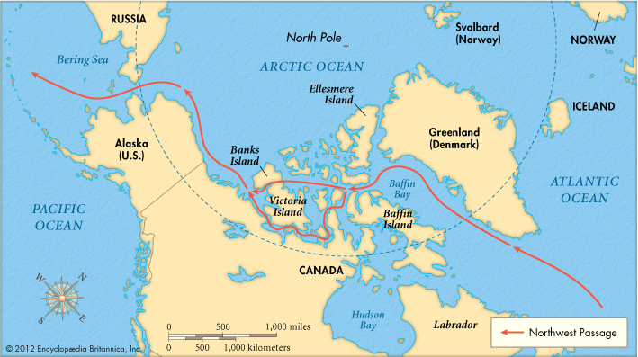
The Northwest Passage
France and England also sent explorers to the New World.
Ignored the Treaty of Tordesillas.
Explored further north in search of a route to Asia.

Slide 9
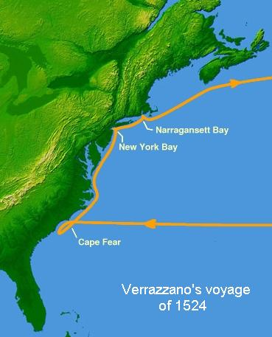
Giovanni da Verrazano
Sails from France and arrives off the coast of North Carolina in 1524.
Lands near Cape Fear and sails around the Pamlico Sound.
Believed he found the Pacific Ocean.
First European to visit NC.
Continues to sail north toward New York and sails around the Hudson Bay, then returned to France.

Slide 10
Other Explorers
Ponce de Leon
Discovers Florida looking for the fountain of youth
Claims Florida for Spain.
Vasquez de Ayllon
Led first attempt from Spain to settle NC.
Expedition was a failure.
Hernando de Soto
Led first explorers into NC in search of gold.
Explored southwest US and the Mississippi River.

Slide 11
Spain Gives Up
Spain’s failed attempts to establish a settlement in present day U.S. proved costly.
Spain gives up.
Other countries now have an opportunity to do what Spain could not…

