Slide 1
The New England Colonies
Chapter 5

Slide 2
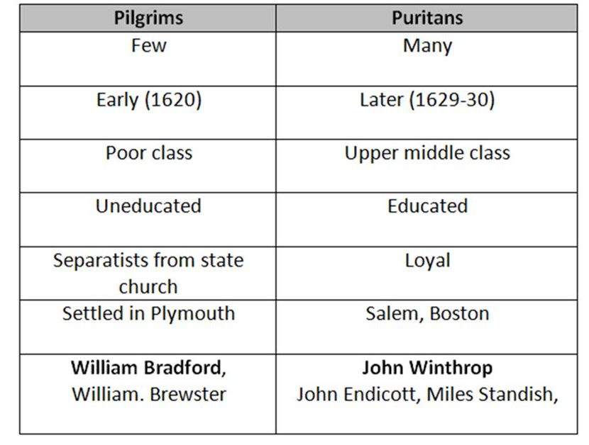
The New England Colonies
Unlike the Jamestown colonists, the settlers of the New England colonies sought to practice their religions as they saw fit.
Puritans
Purify the Church of England
Separatists
Break away from the Church of England
Pilgrims

Slide 3
Separatists flee England
Separatists begin to be punished for their beliefs.
Many begin to flee to the Netherlands so they could worship freely.
Fearing that their children were losing English customs, they decide to go to America.
Became known as Pilgrims because they were taking a long journey.

Slide 4
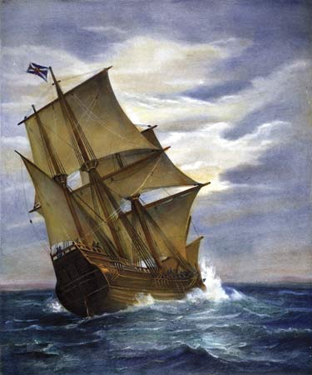
The Mayflower Compact
The Pilgrims set sail for Virginia on a ship called The Mayflower.
The Pilgrims get off course and land in present day Massachusetts.
This land had no government, so the Pilgrims drew up an agreement called the Mayflower Compact.
Considered one of the first forms of government in the US.
Colony was called Plymouth

Slide 5
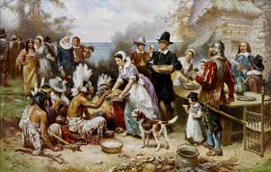
Colonists meet Natives
Colonists at Plymouth struggle to survive the harsh winters.
Leaders of the Wampanoag tribe visited Plymouth and taught them how to survive by hunting and farming.
In the fall, they celebrated the first harvest with a feast.
Thanksgiving.

Slide 6
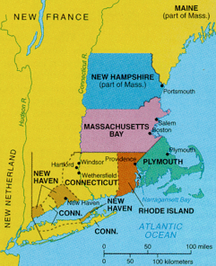
Massachusetts Bay Colony
Puritans get fed up with the Church of England and decide to leave for Massachusetts.
The Great Migration
Puritans were better prepared than they Pilgrims were.
Generally wealthier, more educated and more powerful.
Create the Massachusetts Bay Colony.

Slide 7
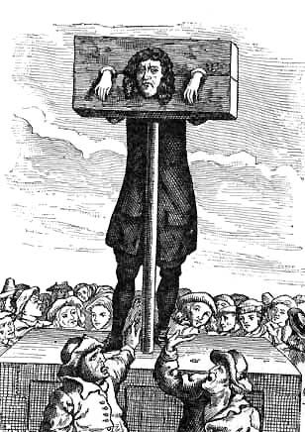
The Puritan Way of Life
Extremely rigid society centered around the Church.
Emphasized duty, godliness, hard work, and honesty.
Puritan law required everyone to be literate so they could read the bible.
People begin to leave Massachusetts to break away from the puritans.
Create new colonies.

Slide 8
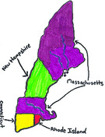
Puritan Intolerance leads to new colonies
Rhode Island
Founded by Roger Williams and Anne Hutchinson.
People could practice religion freely.
Connecticut
Founded by Thomas Hooker
Wanted better farm land and religious freedom.
New Hampshire.
People sought freedom and farm land.
Wanted to profit from the fur trade.

Slide 9
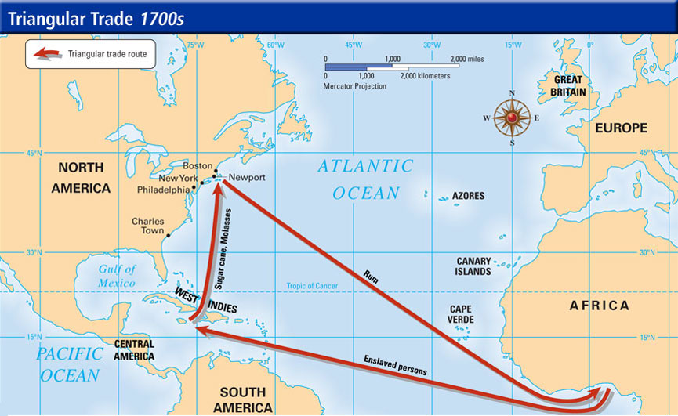
Triangular Trade
Trade route between the New England colonies, West Africa and the West Indies.
Enslaved Africans are brought to the colonies from Africa.

