Slide 1
North Carolina as a Colony
Chapters 6, 7 & 8

Slide 2
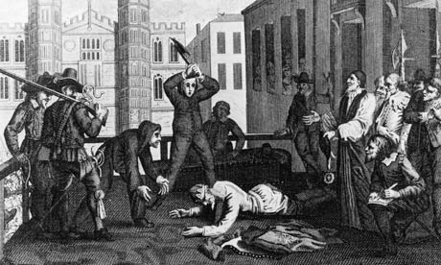
Civil War Breaks out in England
During the reigns of James I and Charles I, Puritans could not worship freely in England.
Some migrated to America.
When Charles I begins to grow his power, Parliament fights him.
Soon civil war breaks out between Charles I and Parliament, led by the Puritans.
Charles is defeated and executed.

Slide 3
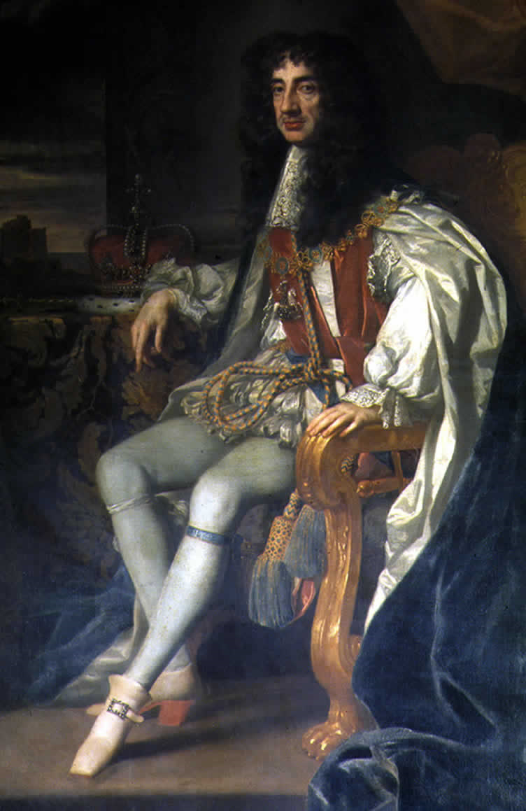
Charles II Takes the Throne
The monarchy is abolished and Oliver Cromwell rules England.
Basically a military dictator.
After Cromwell dies, the newly elected Parliament invited Charles’s son, who was in exile in Europe, to take the throne as Charles II.

Slide 4
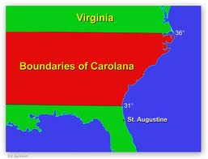
The Lords Proprietors
Charles II wanted to reward the men who had stayed loyal to him while he was in exile.
Grants 8 of them vast tracts of land in the Americas.
They become the Lords Proprietors
The land is named Carolana after the Latin form for his own name and is later renamed Carolina.

Slide 5
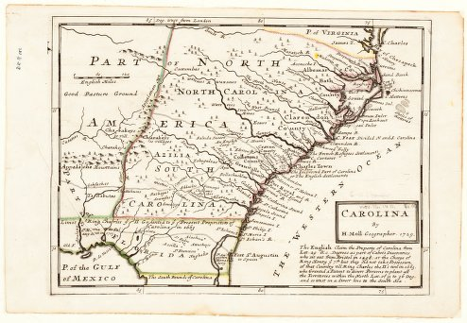
A Proprietary Colony
The Lords Proprietors want the land to be settled quickly so they could make money.
3 Counties are created:
Albemarle
Clarendon
Craven
The colony grows very slowly because:
Forests, swamps and rivers made travel difficult.
The Proprietors only gave out small parcels of land
Land taxes or quitrent were high.

Slide 6
Political Parties Develop
Prerogative Party
Believed that a government independent of the people would be best.
Popular Party
Believed that the will of the people should determine government actions.

Slide 7
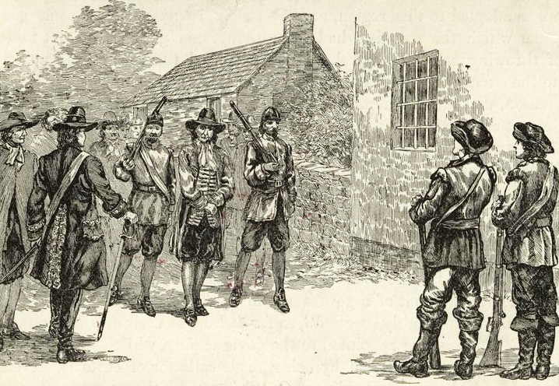
Culpepper’s Rebellion
Uprising in NC in which the Popular Party took control of the government.
Culpepper was arrested and tried for treason.

Slide 8
Cary’s Rebellion
Government officials were forced to swear an oath to England.
Many Quakers protested and Gov. Cary revoked the law.
NC splits in 1712 and Gov. Hyde takes over and overturns the laws made by Cary.
Cary boards a ship and shoots cannonballs at Hyde’s house.
Cary is captured and sent back to England.
First drive-by in history!

Slide 9
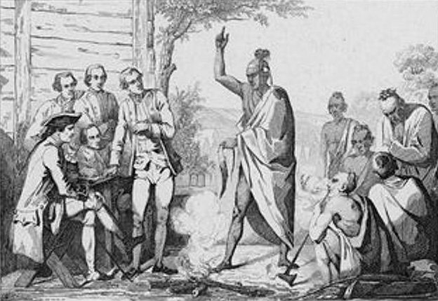
Tuscarora War
The Tuscarora natives were angry about being cheated out of land.
Saw the colonists vulnerable after bad growing season.
Tuscarora’s attack for three days killing many colonists.
SC sends help and the Tuscarora’s are defeated.
Many natives leave NC and head north.

Slide 10
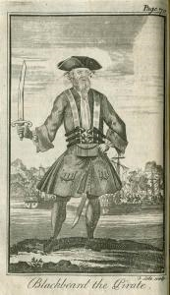
Piracy in North Carolina
Many hidden inlets and small harbors along NC’s coast made excellent hideouts for pirates.
Edward Teach, better known as “Blackbeard,” was a frequent visitor to North Carolina.
He was captured and killed in NC.
The 1710s have been called the “golden age of piracy.”

