Slide 1
Events Leading towards Revolution
Chapter 9

Slide 2
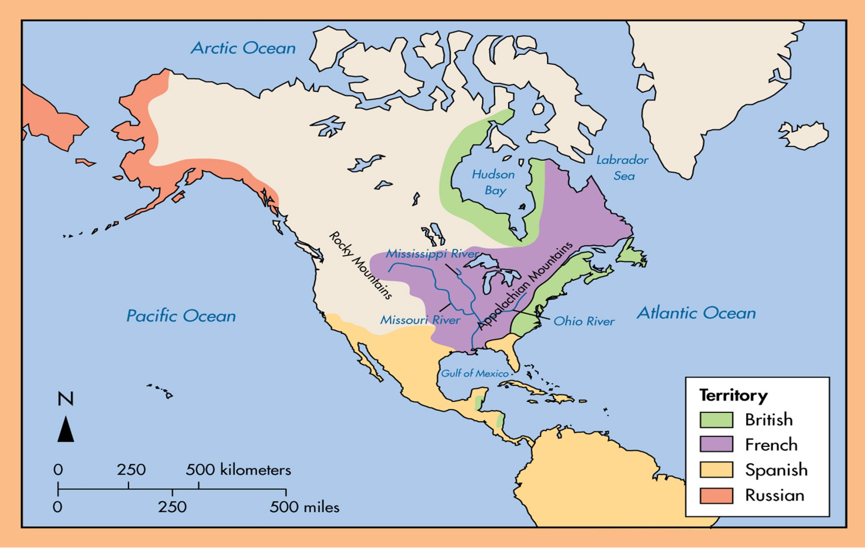
The French and Indian War
The French and the British both claimed the Ohio River Valley.
George Washington carries a letter to the French demanding that they leave the area.
They refuse.
Britain must now lose the Ohio River Valley or fight for it.

Slide 3
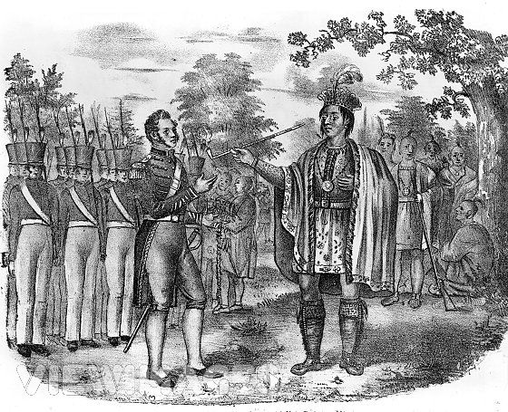
Native Americans Choose Sides
British officials and representatives from the colonies attempt to convince the Iroquois to fight for them.
The Iroquois ultimately fight on the side of the French.
Had better relations with the French than the British.
Most thought the French would win.,

Slide 4
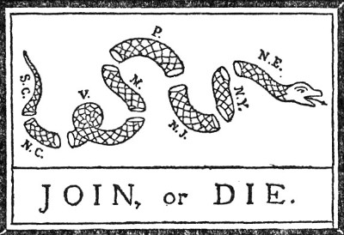
The Albany Plan of Union
Created by Benjamin Franklin.
A plan for colonial defense that called for each colony to send delegates to a council.
The council would make decisions for all of the colonies.
Purpose of the plan was to unite the colonies.

Slide 5
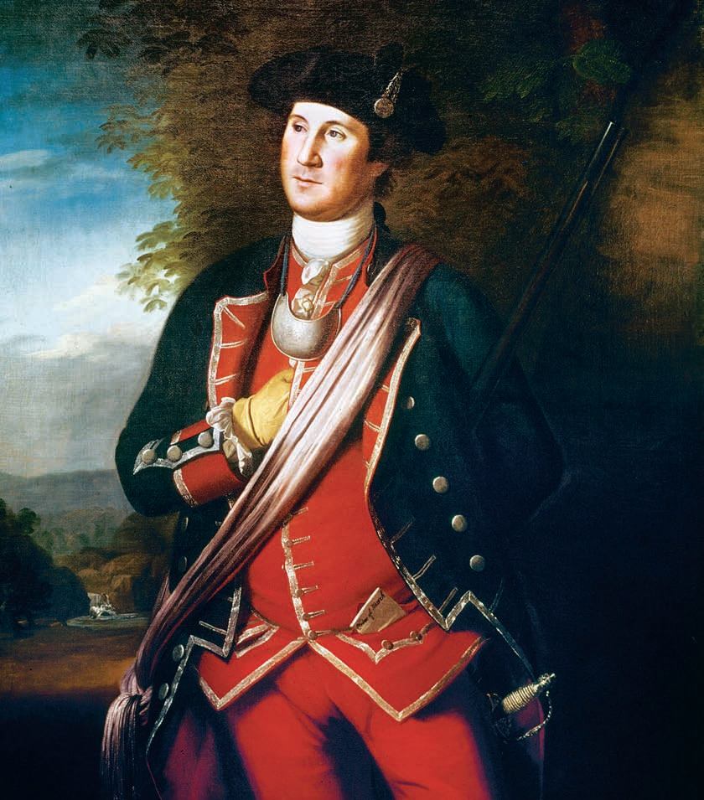
The Fighting Begins
George Washington launches an attack from Fort Necessity.
The French quickly surround the fort and defeat the British.
Neither France or Britain declare war for two years.
Rely on Native American allies to do the fighting.
In 1756, war is declared and it quickly turns into a global struggle for world power.

Slide 6
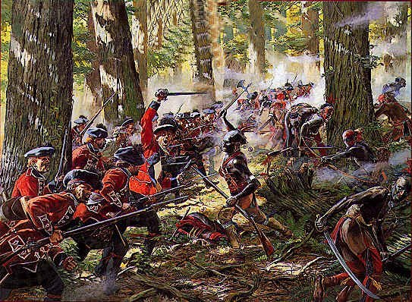
The War Comes to an End
Britain is defeated in many of the early battles.
Britain is finally able to capture Fort Duquesne and renamed it Fort Pitt.
Will later become Pittsburgh
The British are also able to capture Quebec, which signals the end of the war.

Slide 7
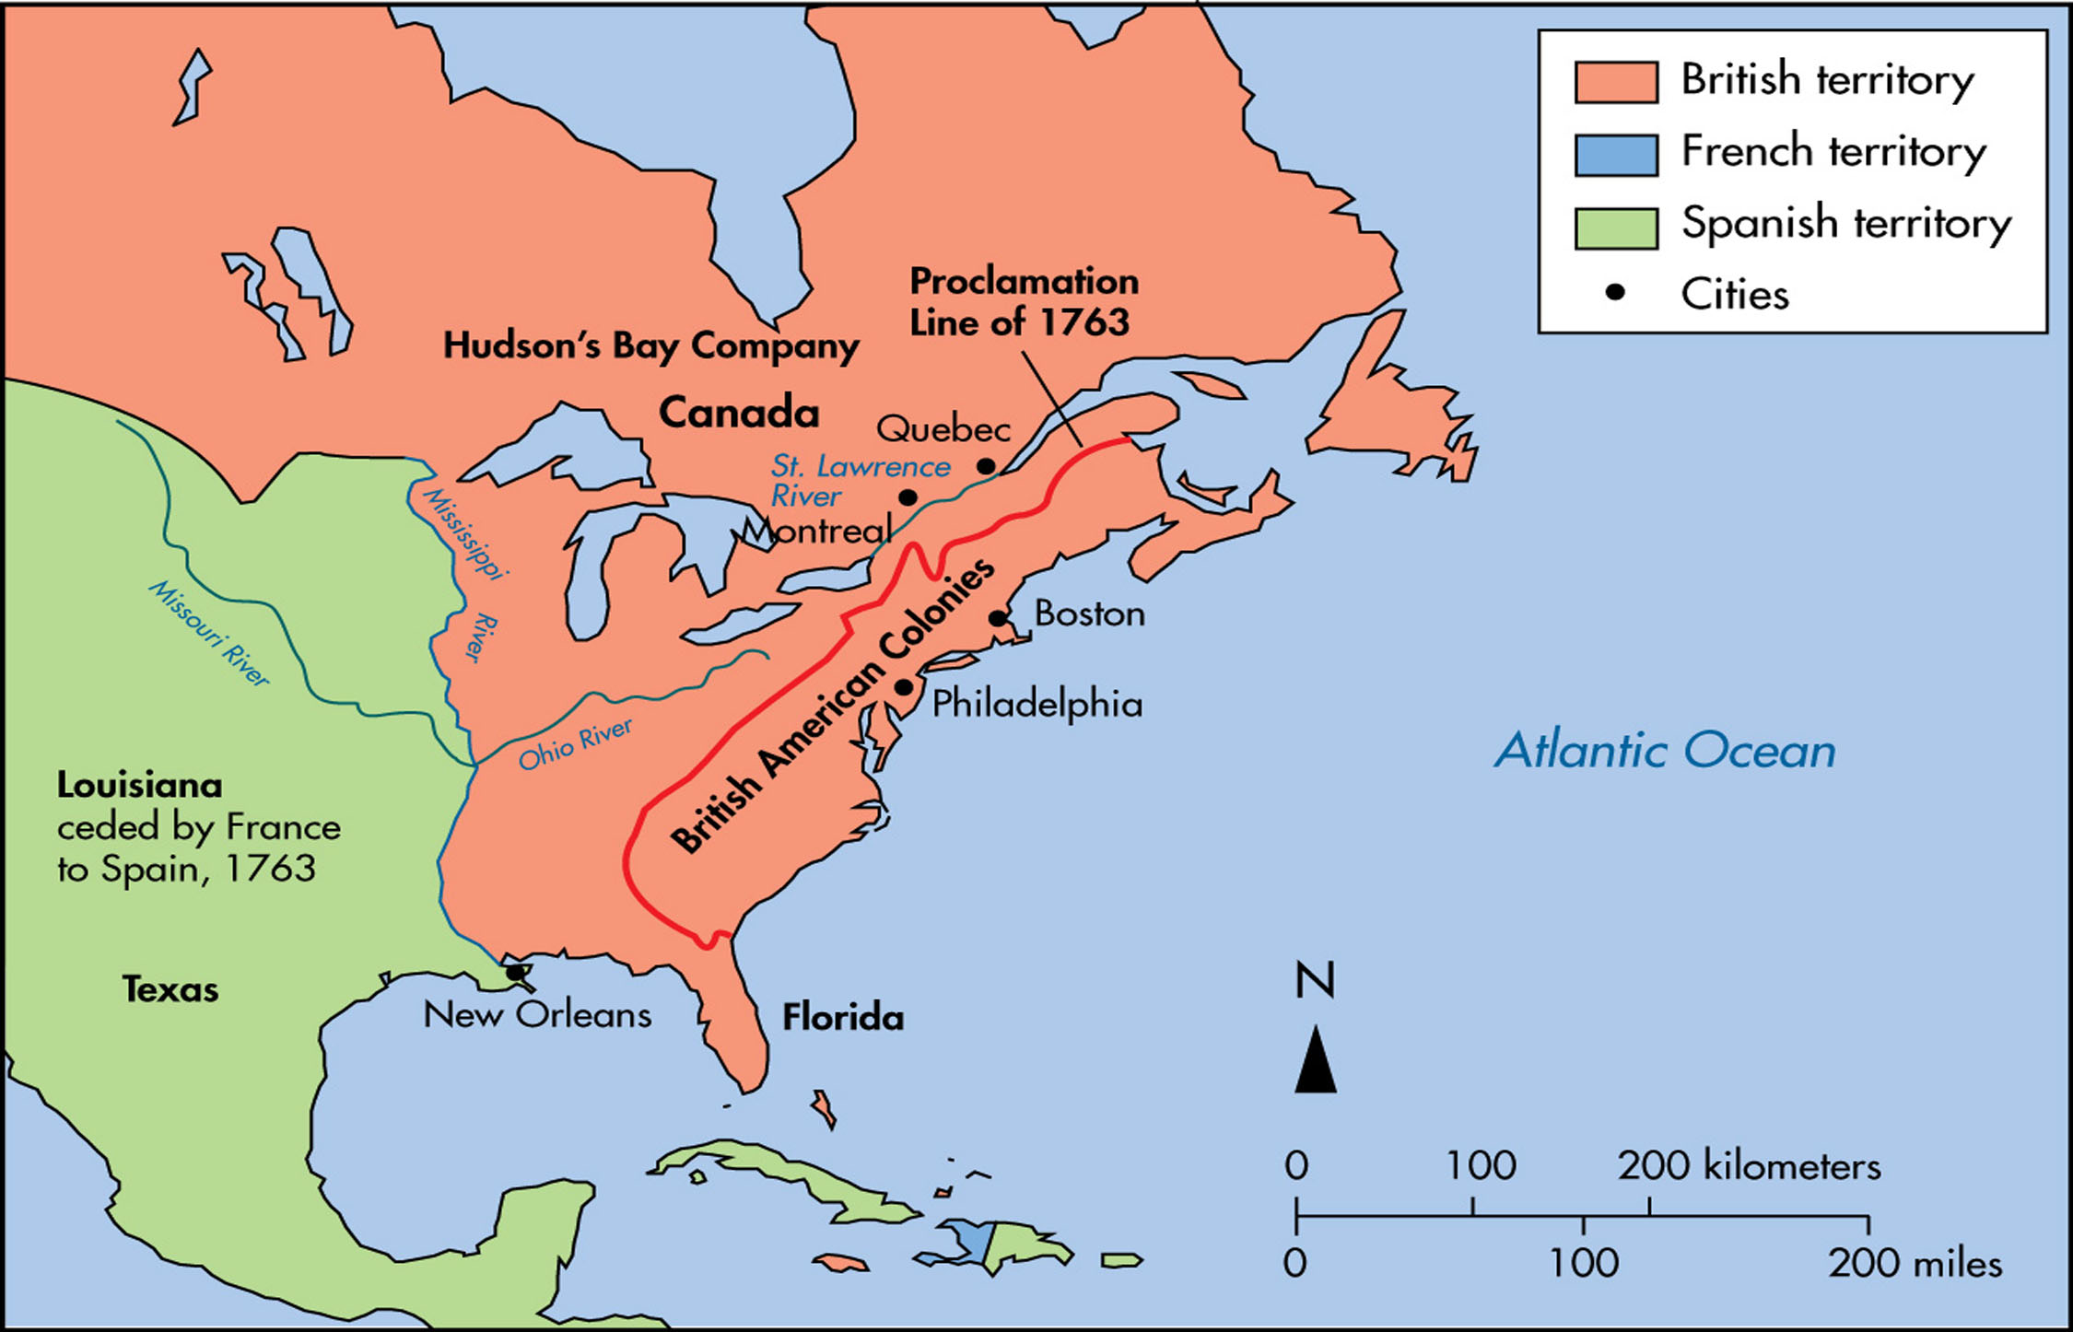
The Treaty of Paris of 1763
Britain gained Canada and all of the French land east of the Mississippi River.
Spain gave up Florida to Britain.
England now has a lot of DEBT from the war.

Slide 8
Results of the War
Unrest in the colonies led the British to send more soldiers to the colonies.
Since the war was fought to benefit the colonists, the British government felt the colonists should help pay for it.

Slide 9
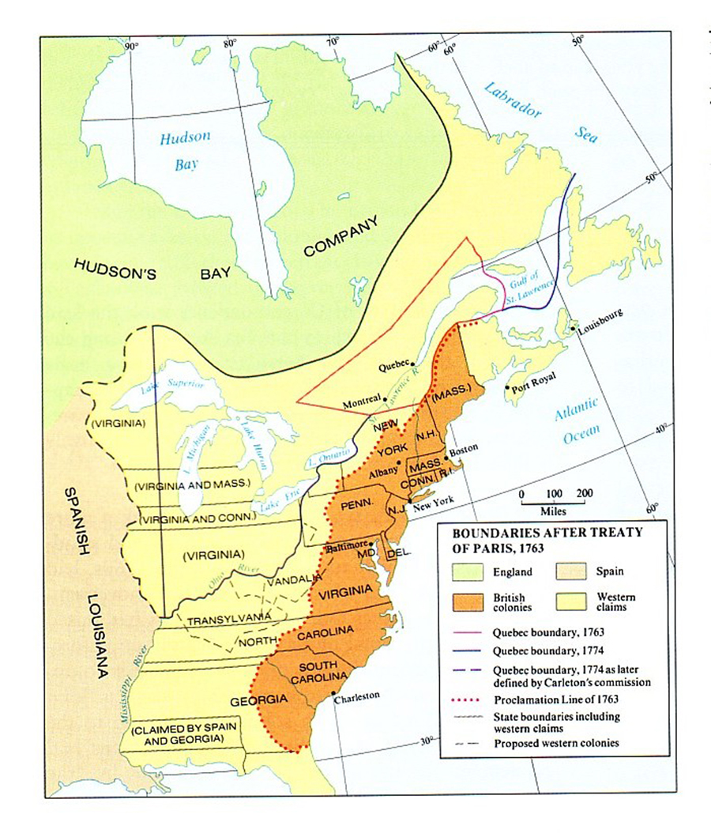
Proclamation of 1763
Chief Pontiac led Natives in attacks against British settlements.
Pontiac’s Rebellion
The British drew a line down the Appalachian Mountains and would not let colonists into the lands west of the line.
Hoped to avoid a costly war with Natives.
Pontiac stops attacks, but colonists protest the new laws.

Slide 10
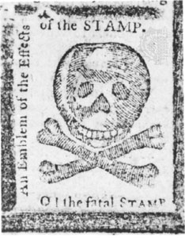
new taxes Imposed on Colonists
Sugar Act
Increased taxes on molasses, wine and silk.
Quartering Act
Required colonists to feed and shelter British troops.
Stamp Act
Required colonists to pay a tax for paper items.
Townshend Acts
Taxed tea, glass, paint and lead.
Paid the salaries of royal officials in colonies.

Slide 11
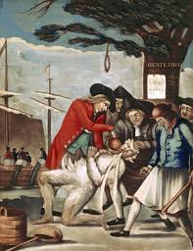
Colonists Protest
Colonists believed that they did not vote for members of parliament, parliament had no right to tax them.
“No taxation without representation”
The Sons of Liberty lead many protests and boycotts.
Stamp Act is repealed.

Slide 12
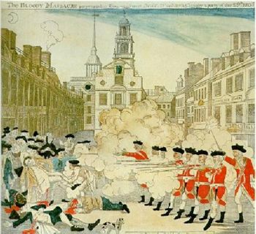
The Boston Massacre
On March 5th, 1770, a group of unarmed colonists gather in Boston.
They began to insult a British soldier.
More soldiers gathered and shots rang out.
5 colonists were mortally wounded.

Slide 13
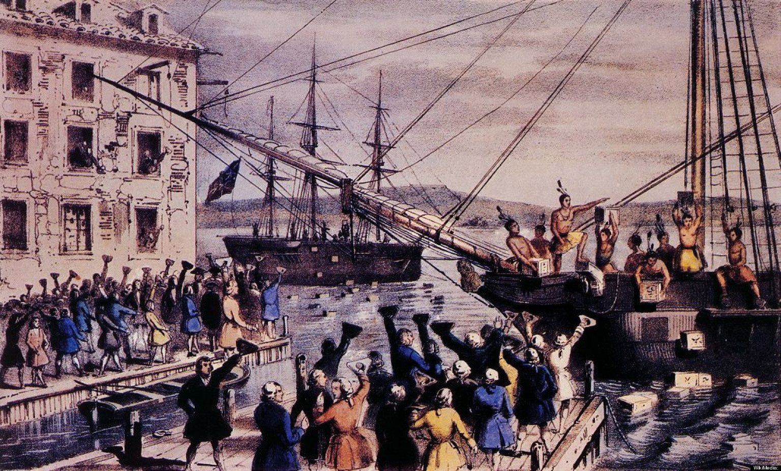
The Boston Tea Party
Parliament enacts the Tea Act, which placed a tax on tea.
Colonists in Boston responded by boarding ships in dressed as Native Americans.
They dumped over 300 chests of tea into Boston Harbor.

Slide 14
The Intolerable Acts
Actually named the Coercive Acts.
Parliament passed these laws in response to the Boston Tea Party.
Sealed off Boston Harbor until the colonists paid for the damage.
Also placed the colony under military control.

