Slide 1
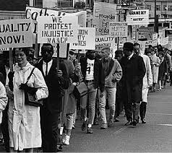
Civil rights movement

Slide 2
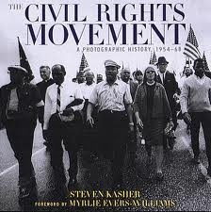
What do you already know?
Make a list of what your already know about the Civil Rights Movement.

Slide 3
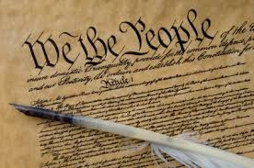
What are civil rights?
Civil rights are rights all citizens of the U.S. are granted by the constitution.
After the Civil War many African Americans although they were free, were not receiving their Civil Rights

Slide 4
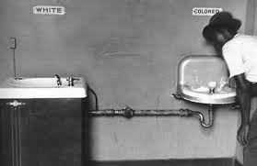
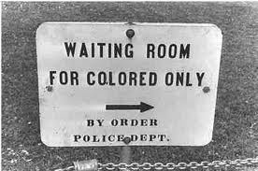
Plessy v. Ferguson 1896
Supreme court ruling that stated all citizens have equal rights but had to be segregated.
“Separate but Equal”

Slide 5
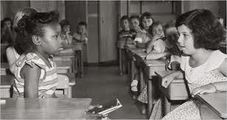
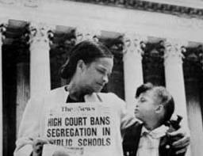
Brown v. Board of Education 1954
Supreme court ruling that overturned “Plessy v. Ferguson” and made segregation in public schools illegal.

Slide 6
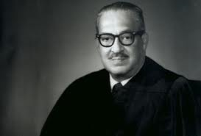
Thurgood Marshall
Attorney in the “Brown v. Board of Education” case and who later became the first African American Supreme Court Justice.

Slide 7
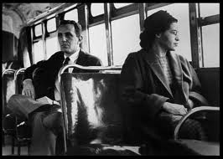
Rosa parks 1955
Rosa Parks refuses to give up her bus seat to a white passenger which led to the Montgomery Bus Boycott.

Slide 8
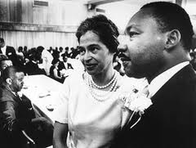
Montgomery bus boycott 1955
Many citizens of Montgomery refused to ride the city busses for 13 months until the law changed. Martin Luther King was a leader of the boycott.

Slide 9
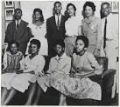
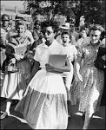
Little Rock Nine 1957
Nine African American students enrolled in an all white school in Little Rock, Arkansas. They were met with resistance and protests.
Elizabeth Eckford Story 4:00 minutes

Slide 10
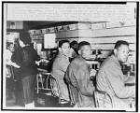
Greensboro Sit-In 1960
In Greensboro, NC four NC A &T African American college students sat at a restaurant lunch counter. The were refused service but sat there until the restaurant closed?
Greensboro sit in 3:00minutes
What do you think this
accomplished?

Slide 11
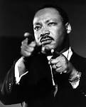
March on Washington 1963
Martin Luther King led a march in Washington D.C. where he gave his “I have a Dream” speech.
I have a dream speech 2:00 minutes

