Slide 1
Unit 7 The Progression of North Carolina 1800-1860

Slide 2
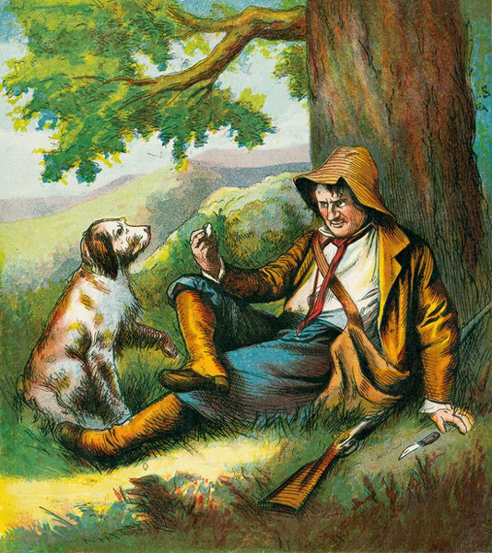
Rip Van Winkle State
North Carolina was committed to small government and an agrarian economy.
North Carolina lacked educational opportunities, economic growth, and methods of transportation.
Many felt that time was passing the state by and that North Carolina was asleep, just like Rip Van Winkle (neighboring states were bustling with production and trade).

Slide 3
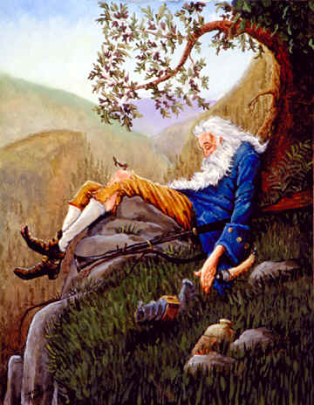
Rip Van Winkle State
Rip Van Winkle goes off into the mountains and falls asleep for twenty years — missing the American Revolution and all of the changes it brought.
Many North Carolinians were beginning to feel that time was passing their state by just as it had Rip Van Winkle.
The state’s leaders were committed to a small government and an agricultural economy. It was named so because more than few considered the state’s economy to be asleep while
But with poor transportation, no public education, and little economic opportunity, thousands of North Carolinians left the state each year seeking a brighter future elsewhere.

Slide 4
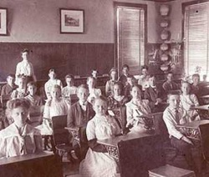
North Carolina’s Education Crisis
The State of North Carolina had no system of Public Education in the 1800’s.
Academies were the only form of schooling.
They depended on local funding and tuition.
As a result:
Many could not read or write
Most worked in the Agricultural Region performing manual labor.
SHOULD PEOPLE HAVE TO PAY FOR EDUCATION OR SHOULD THEIR BE FREE PUBLIC EDUCATION?

Slide 6
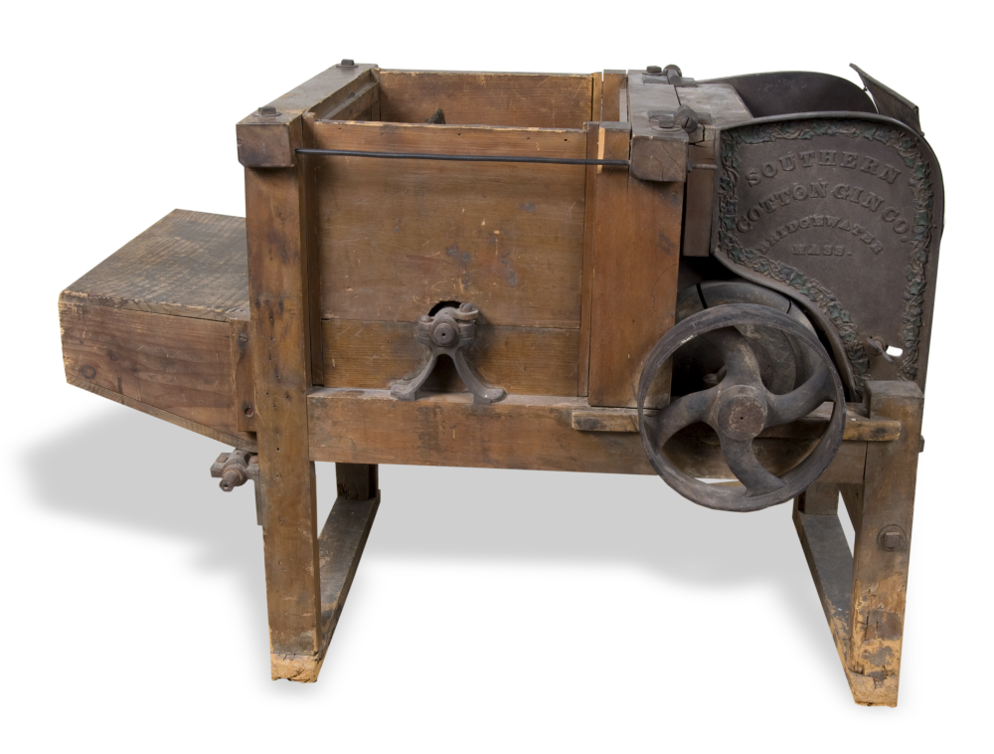

Slide 8
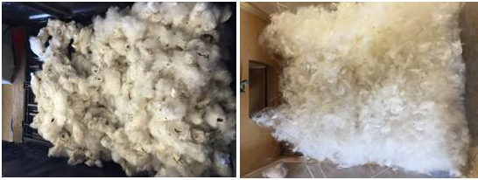
Before & After
https://www.youtube.com/watch?v=6eT4bNxkv-c
https://www.youtube.com/watch?v=A6wPxAp-1Jc

Slide 9
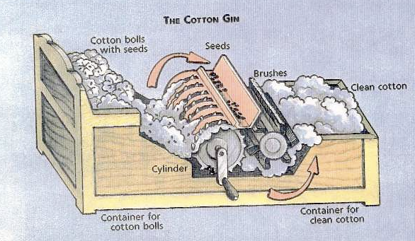
North Carolina’s Land and Economy
Our economy was dependent on Agriculture (Cotton)
The invention of the Cotton Gin by Eli Whitney greater increased this.
More farmland was needed
Manufacturing declines as cotton booms and NC becomes a one crop state

Slide 10
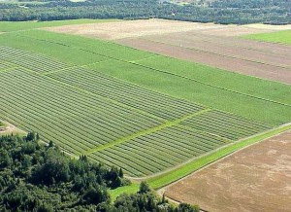
Crop rotation (or lack of it)
Southern states were the source for cotton
“King Cotton”
Cotton drains the soil of it’s nutrients
Farmers were slow to realize this, so they sought out more land
That land was occupied by Indians.

Slide 11
Indian Removal Act
The Cherokee nation was a tribe that had assimilated very well into American culture. (spoke English, practiced Christianity, etc.)
Lived on much of the land between Appalachia and the Mississippi River.
In the early 1800’s this land became sought after with the invention of the cotton gin, the expansion of cotton farming and the gold and silver found on the land.
Gov’t wanted land, but supreme court said Native lands are not property of U.S. or the state.
President Jackson would not enforce this decision. Jackson then established the “Indian Removal Act” in 1830.
States need land to prosper, Natives need to be saved from settlers who violently tried to take land.

Slide 12
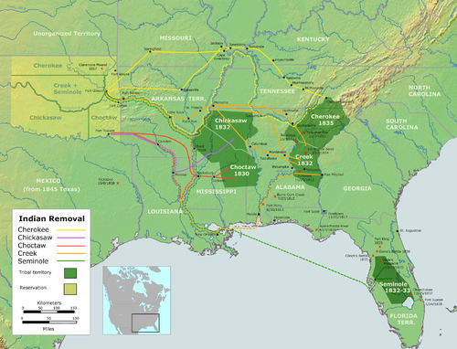

Slide 13
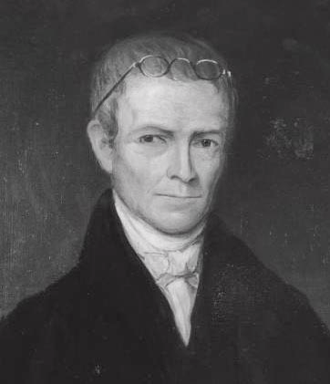
Education Reform
Archibald Murphey fought for Public Education in NC.
He wrote his “Report of Education” which gave ideas on how to set up a public school system.

Slide 14
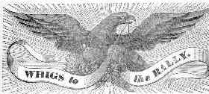
Politics in North Carolina
The North Carolina State Government adopted its first State Constitution in 1835.
Representatives from Eastern and Western NC could now debate issues for the first time.
Two Political Parties form in NC:
The Democratic Party
The Whig Party
Many of the Changes in the Constitutional Convention of 1835 brought the “Rip Van Winkle State” back to life.

Slide 15
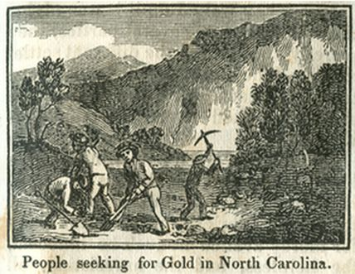
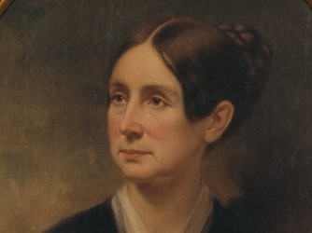
Changes in North Carolina
Many Railroads were created for easier travel and trade.
The “North Carolina Gold Rush” brought many immigrants industries to the Piedmont Region of NC.
Dorothea Dix brought many reforms to North Carolina for people who suffered from Mental Disabilities.

Slide 16
Result of Reforms
The reforms made from 1840-1860 made North Carolina one of the most Progressive States
Reforms in ….
Education
New Technologies (railroads)
Industries (mining)
Government
…. led to increased economic development and greater prosperity.

